Slide 1
While you’re waiting…
Tra’ch bod chi’n aros...
Like “Cardiff SU Guild of Societies”
Add “Lamorna Hooker SU”
Add “Sam Societies Cook”
Follow @SocietiesCSU
Hoffwch ‘Cardiff SU Guild of Societies”
Ychwanegwch “Lamorna Hooker SU”
Ychwanegwch “Sam Societies Cook”
Dilynwch @SocietiesCSU

Slide 2
New Committee Welcome Talk
Sgwrs Groesawu’r Pwyllgor Newydd

Slide 3
Congratulations!
Llongyfarchiadau!

Slide 4
What does a committee member do?
Beth mae aelod pwyllgor yn ei wneud?
Lead your Society and ensure things go smoothly
Decide on and arrange activities
Arwain eich Cymdeithas a sicrhau bod pethau’n rhedeg yn effeithlon
Penderfynu ar weithgareddau a’u trefnu

Slide 5
What does a committee member do?
Beth mae aelod pwyllgor yn ei wneud?
Point of contact between Society and the Guild
Represent your Society’s needs on campus
Bod yn bwynt cyswllt rhwng y Gymdeithas a’r Urdd
Cynrychioli anghenion eich Cymdeithas ar y campws

Slide 6
The Guild of Societies
Urdd y Cymdeithasau
We are the organisation your Society affiliates to
We provide support, training, resources, events and activities
There are a few things we expect from all Societies…
Ni yw’r sefydliad cyswllt i’ch Cymdeithas
Rhown gymorth, hyfforddiant, adnoddau, digwyddiadau a gweithgareddau
Mae rhai pethau rydyn ni’n eu disgwyl gan bob Cymdeithas...

Slide 7
Bronze Tier
www.cardiffstudents.com/activities/societies/resources/tiers/
Haen Efydd
The Bronze Tier outlines the minimum requirements for a Society
Make sure you understand what to do for Bronze Tier
They may be updated over the summer
Mae’r Haen Efydd yn nodi gofynion sylfaenol i Gymdeithas
Sicrhewch eich bod yn deall beth i’w wneud i’r Haen Efydd
Gallai’r gofynion gael eu diweddaru dros yr haf

Slide 8
Current Bronze Tier
www.cardiffstudents.com/activities/societies/resources/tiers/
Haen Efydd ar hyn o bryd
Membership of at least 20 members registered through the SU.
Committee includes a President, Secretary and Treasurer.
All committee members are students of Cardiff University and paid members of the Guild of Societies and their Society.
Register all activity with the Union and all participants as Society members or through another SU department or activity.
At least two committee members attend all compulsory training sessions.
At least three members attend the Students’ Union AGM.
Provide feedback on Society experience at Society Forum.
Keep all society funds in the Students’ Union bank account and keep a constant positive balance, unless pre-agreed.
Gydag o leiaf 20 aelod a gofrestrir drwy UM
Pwyllgor yn cynnwys Llywydd, Ysgrifennydd a Thrysorydd.
Holl aelodau’r pwyllgor yn aelodau Prifysgol Caerdydd ac yn aelodau â thâl Urdd y Cymdeithasau a’u Cymdeithas.
Cofrestru’r holl weithgareddau â’r Undeb a phawb sy’n aelodau Cymdeithas, neu drwy adran neu weithgaredd arall UM.
O leiaf ddau aelod pwyllgor yn mynychu’r holl sesiynau hyfforddiant gofynnol.
O leiaf dri aelod yn mynychu CCB Undeb y Myfyrwyr.
Rhoi adborth ar brofiadau’r Gymdeithas yn Fforwm y Cymdeithasau.
Cadw holl gyllid y gymdeithas yng nghyfrif banc Undeb y Myfyrwyr a sicrhau nad yw’r cyfrif mewn dyled oni chytunir fel arall

Slide 9
Current Bronze Tier
www.cardiffstudents.com/activities/societies/resources/tiers/
Haen Efydd ar hyn o bryd
Adhere to a valid constitution, your agreement between the SU and the Society.
Submit an up-to-date record of all equipment owned by the Society, using our Template Inventory.
Run a democratic committee election, hold an AGM and take minutes of AGM.
Submit all requested documents by the deadlines set by the Societies Team.
Organise at least 2 socials or events per semester, 1 of these being non-alcoholic.
Turn up to allotted stand and adhere to the guidelines set at Societies Fair or Heath Fair.
Adhere to the Guild of Societies Social Policy.
Accurate and up-to-date online content on cardiffstudents.com.
Cydymffurfio â chyfansoddiad dilys, eich cytundeb rhwng UM a’r Gymdeithas.
Cyflwyno cofnod cyfoes o holl offer y Gymdeithas gan ddefnyddio ein Templed Rhestr Offer.
Cynnal etholiad pwyllgor democrataidd, cynnal CCB a chymryd cofnodion ohono
Cyflwyno’r holl ddogfennau gofynnol erbyn terfynau amser y Tîm Cymdeithasau.
Trefnu o leiaf 2 ddigwyddiad bob tymor, gydag 1 yn ddialcohol
Troi fyny i’r stondin ddynodedig a chydymffurfio â’r canllawiau a bennir yn Ffair y Cymdeithasau neu Ffair y Mynydd Bychan.
Cydymffurfio â Pholisi Cymdeithasol Urdd y Cymdeithasau
Cadw cynnwys cywir, cyfoes ar-lein yn cardiffstudents.com

Slide 10
Memberships
Aelodaethau

Slide 11
Selling Memberships
Gwerthu Aelodaethau
Members are only members when they buy a membership
All members must join the Guild first - £6 per year
Buy memberships on your webpage or at the Fairs from September
Dyw aelodau ond yn aelodau ar ôl talu ffi aelodaeth
Rhaid i bob aelod ymuno â’r Urdd yn gyntaf - £6 y flwyddyn
Prynu aelodaeth ar eich gwefan neu yn y Ffeiriau o fis Medi

Slide 12
Selling Memberships
Gwerthu Aelodaethau
Don’t sell memberships in another way!
Review your membership price over the summer
Committee members need to buy memberships too or will be removed from their position!
Peidiwch â gwerthu aelodaeth mewn ffordd arall!
Adolygwch bris yr aelodaeth dros yr haf
Mae angen i aelodau pwyllgor brynu aelodaeth hefyd neu byddant yn cael eu symud o’u swydd!

Slide 13
Key Contacts
Cysylltiadau Allweddol

Slide 14
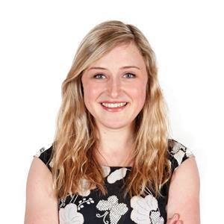
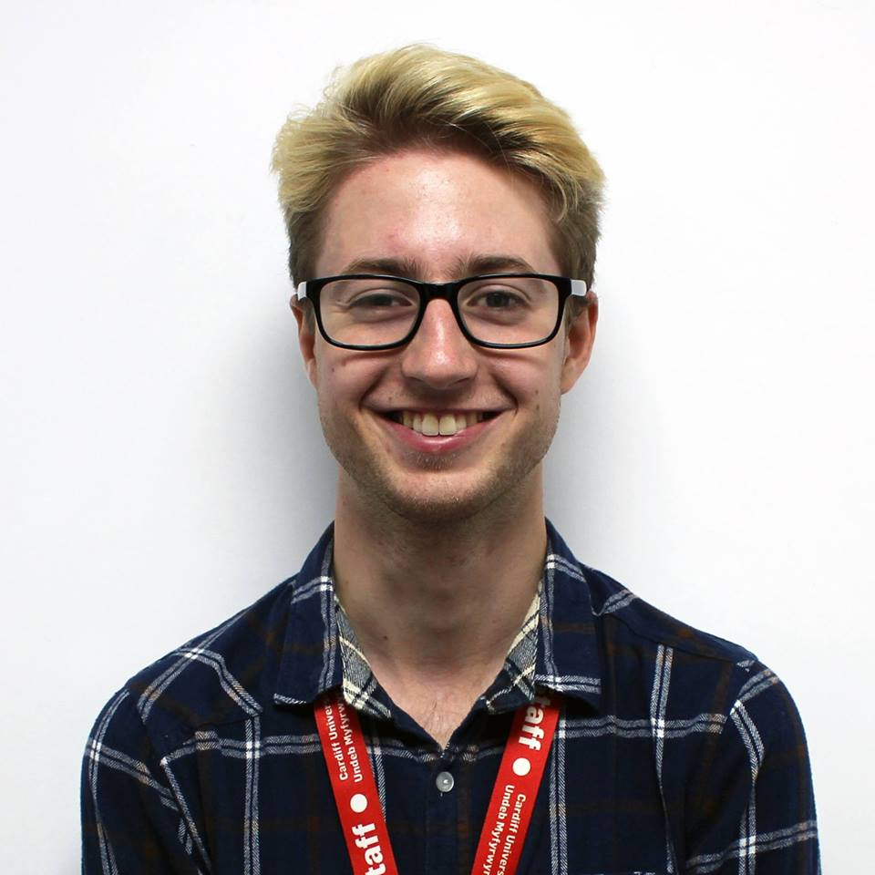
Lamorna Hooker
VP Societies | Is-Lywydd Cymdeithasau
VPSocieties@cardiff.ac.uk
029 2078 1427
@SocietiesCSU
Sam Cook
Societies Coordinator | Cydlynydd Cymdeithasau
Societies@cardiff.ac.uk
029 2078 1433

Slide 15
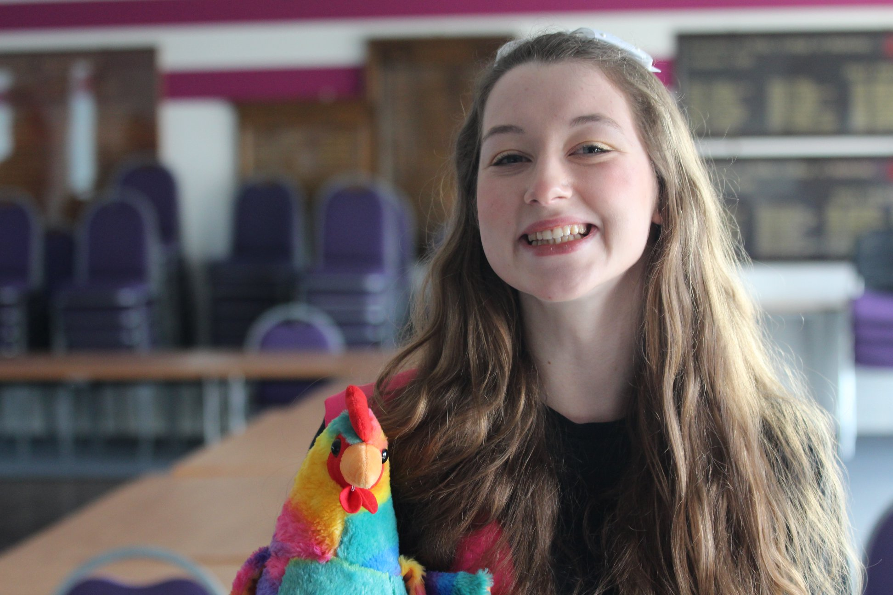
Meet Henri…
Dyma Henri…

Slide 16
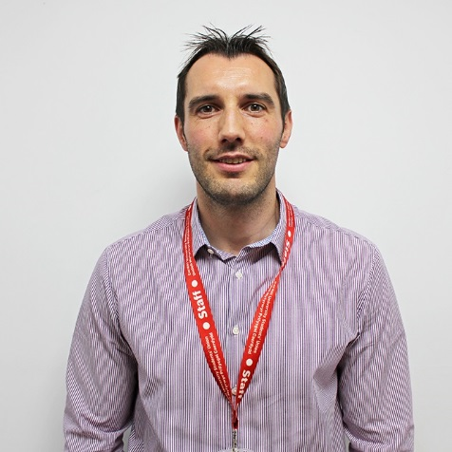
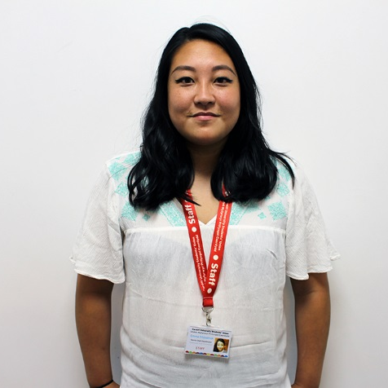
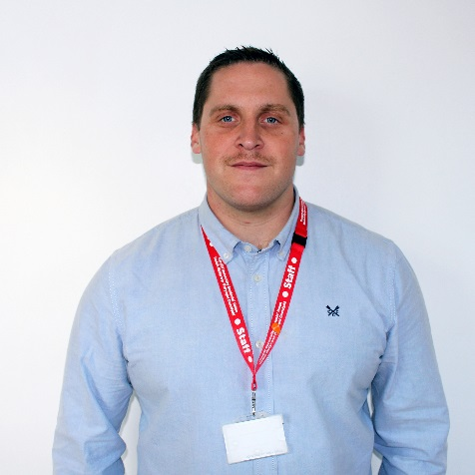
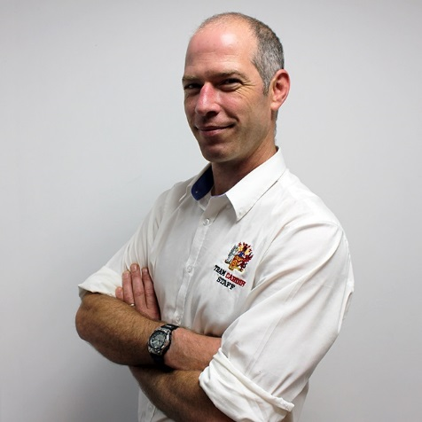

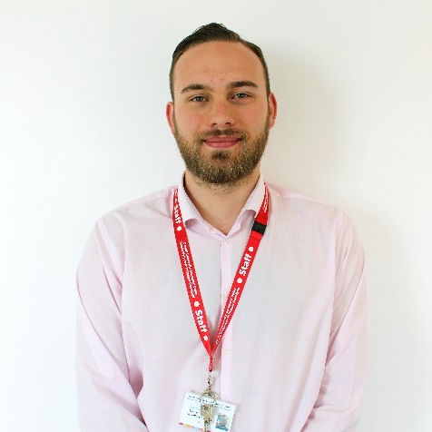
Paul Jones
Head of Student
Activities
Pennaeth Gweithgareddau Myfyrwyr
JonesPD4@cardiff.ac.uk
Emma Fitzpatrick
AU
Coordinator
Cydlynydd Undeb
Athletau
FitzpatrickE1@cardiff.ac.uk
Ioan Evans
Activities Safety Coordinator
Cydlynydd Diogelwch Gweithgareddau
EvansI17@cardiff.ac.uk
Alex Bazley
Transport
Coordinator
Cydlynydd
Trafnidiaeth
SUTransport@cardiff.ac.uk
Give it a Go | Rhowch Gynnig Arni
GiveitaGo@cardiff.ac.uk
Nathaniel Fox
Finance
Assistant
Cynorthwy-ydd
Cyllid
SUFinance@cardiff.ac.uk

Slide 17
Summer Checklist
Rhestr Wirio dros yr Haf

Slide 18
Hold a committee meeting
Plan your activities for first Semester
Write a Development Plan
Submit Regular Room Booking Requests
Submit Give it a Go Sessions
Update webpage and Social Media
Apply for Grants
Check you official email
Cynhaliwch gyfarfod pwyllgor
Cynlluniwch eich gweithgareddau i’r tymor cyntaf
Lluniwch Gynllun Datblygu
Cyflwynwch Geisiadau Rheolaidd i Gadw Ystafell
Cyflwynwch Sesiynau Rhowch Gynnig Arni
Diweddarwch y wefan a’ch Cyfryngau Cymdeithasol
Gwnewch gais am grantiau
Darllenwch drwy’ch e-bost swyddogol

Slide 19
Core Documents
Dogfennau Craidd

Slide 20
Activities Laws
www.cardiffstudents.com/activities/resources/documents/
Cyfreithiau Gweithgareddau
The core document that underpins all groups in the SU
Familiarise yourself with what is written here – it may come in useful!
Y ddogfen graidd sy’n sail i bob un o grwpiau UM
Darllenwch yr hyn sydd wedi’i nodi ynddi – gallai fod yn ddefnyddiol!

Slide 21
Society Constitution
Cyfansoddiad Cymdeithas
This is your agreement with us
Covers your aims, committee roles, democracy and complaints
Keep your constitution up-to-date
Make sure you have one and understand it
Hwn yw’ch cytundeb â ni
Mae’n nodi’ch nodau, rolau pwyllgor, democratiaeth a chwynion
Cadwch y cyfansoddiad y gyfoes
Sicrhewch fod gennych un a’ch bod yn ei ddeall

Slide 22
Equipment Inventory
Rhestr Offer
All equipment owned by the Society is owned by the Guild
We can insure all your equipment if it is on your inventory
Check your equipment and inventory
Yr Urdd sy’n berchen ar yr holl offer y mae’r Gymdeithas yn berchen arno
Gallwn yswirio’ch holl offer os yw ar eich rhestr offer
Mae angen i chi wybod pa offer sydd gennych a’i roi ar y rhestr

Slide 23
Social and Behaviour Policy
www.cardiffstudents.com/activities/resources/documents/
Polisi Cymdeithasol ac Ymddygiad
Covers expected behaviour at socials and events
Separate policy for members and committee members
Read and understand social and behaviour policy for committees
Yn trafod ymddygiad disgwyliedig mewn digwyddiadau
Polisi ar wahân i aelodau ac aelodau pwyllgor
Darllenwch y polisi hwn i bwyllgorau a sicrhewch eich bod yn ei ddeall

Slide 24
Freshers’ Fairs 2018
Ffair y Glas 2018

Slide 25
Freshers’ Fairs
Ffair y Glas
You are guaranteed a stall at the Societies or Heath Fair if you want it
The Fairs are about selling yourself – make sure you stand out!
Tell us if you don’t want a stall
Cewch stondin yn Ffair y Cymdeithasau/y Mynydd Bychan os hoffech gael un
Nod y Ffeiriau yw gwerthu’ch hun – byddwch yn unigryw!
Rhowch wybod i ni os nad oes eisiau stondin arnoch

Slide 26
Fairs Dates
Dyddiadau Ffeiriau
Fairs will take place in the week beginning 24th September
Send us your Fair Preferences by 31st August (survey released over the summer!)
Bydd y ffeiriau’n cael eu cynnal yn ystod wythnos 24 Medi
Anfonwch eich Dewisiadau Ffair atom erbyn 31 Awst (yr arolwg wedi’i ryddhau dros yr haf!)

Slide 27
Plan your stall and what you’ll do
Bring a table cloth!
Direct people to the tills or your website to sign up
Advertise your Give it a Go sessions and big events
Explain the Guild Fee
Use freebies to entice people to your stall
Engage with students
Cynlluniwch eich stondin a’r hyn a wnewch
Dewch â chadach bwrdd!
Cyfeiriwch bobol at y tiliau neu’ch gwefan i gofrestru
Hysbysebwch eich sesiynau Rhowch Gynnig Arni a’ch digwyddiadau mawr
Eglurwch Ffi’r Urdd
Rhowch bethau allan am ddim i ddenu pobl i’ch stondin
Siaradwch â’r myfyrwyr!

Slide 28
Give it a Go
Rhowch Gynnig Arni

Slide 29
Give it a Go Sessions
Sesiynau Rhowch Gynnig Arni
Recruit new members and generate income
Booklets are placed in all Freshers’ Halls of Residence
We recommend you run 1-3 different sessions per semester
Recriwtio aelodau newydd a chreu incwm
Llyfrynnau ym mhob Neuadd Breswyl myfyrwyr y glas
Dylech gynnal 1-3 sesiwn wahanol bob tymor

Slide 30
Give it a Go Sessions
Sesiynau Rhowch Gynnig Arni
You can make most Society activities into a Give it a Go session
Sessions can take place throughout the year
We can advertise some weekly sessions too
Gallwch wneud y rhan fwyaf o weithgareddau’r Gymdeithas yn rhai Rhowch Gynnig Arni
Gall sesiynau gael eu cynnal gydol y flwyddyn
Gallwn hysbysebu rhai sesiynau wythnosol hefyd

Slide 31
Give it a Go Sessions
Sesiynau Rhowch Gynnig Arni
Taster sessions
Guest Speaker talks
Socials
Training sessions
Campaigns and awareness events
Competitions
Trips
Fundraisers
Sesiynau blas
Sgyrsiau siaradwyr gwadd
Digwyddiadau cymdeithasol
Sesiynau hyfforddiant
Ymgyrchoedd a digwyddiadau ymwybyddiaeth
Cystadlaethau
Teithiau
Digwyddiadau Codi Arian

Slide 32
Give it a Go Sessions
www.cardiffstudents.com/activities/give-it-a-go/run-session/
Sesiynau Rhowch Gynnig Arni
Submit your Give it a Go Sessions online by 25th July
Make sure you have a suitable venue booked!
Check the proofs!
Cyflwynwch eich Sesiynau Rhowch Gynnig Arni ar-lein erbyn 25 Gorffennaf
Cofiwch gadw lleoliad addas iddynt!
Prawfddarllenwch bopeth!

Slide 33
Give it a Go Trips
Teithiau Rhowch Gynnig Arni
Give it a Go run lots of weekend trips around the UK
You can collaborate with Give it a Go to take your members
We will add a special ticket to your webpage to sell
Mae gan Rhowch Gynnig Arni lawer o deithiau penwythnos ar draws y DU
Gallwch gydweithio â Rhowch Gynnig Arni i fynd â’ch aelodau
Byddwn yn ychwanegu tocyn arbennig i’ch gwefan i werthu

Slide 34
Trips Abroad
Teithiau Tramor
Give it a Go also helps Societies run trips to Europe
Organise marketing, travel, accommodation, itinerary and trip leader
Need minimum requirement of 40 people on the trip
Mae Rhowch Gynnig Arni hefyd yn helpu Cymdeithasau i drefnu teithiau i Ewrop
Trefnu marchnata, teithio, llety, rhestr offer ac arweinydd taith
Mae angen i o leiaf 40 o bobl fynd ar y daith

Slide 35
Finance
Cyllid

Slide 36
Treasurer Homework
portal.cardiffstudents.com
Gwaith Cartref i Drysorwyr
Use Society funds by submitting a Finance Request
Check out the portal and the Finance Request Form
Try submitting a finance request
Check your Society Balance
Defnyddiwch gyllid y Gymdeithas drwy gyflwyno Cais am Gyllid
Ewch i’r porthol a’r Ffurflen Cais am Gyllid
Ceisiwch gyflwyno cais am gyllid
Cadwch lygad ar Falans eich Cymdeithas

Slide 37
Evidence of Finance Requests
Tystiolaeth o Geisiadau am Gyllid
If you buy stuff for your Society, make sure you get evidence!
Evidence must demonstrate what you bought and how much was spent
Os prynwch bethau i’r Gymdeithas, gofiwch i allu profi hynny!
Rhaid i’r dystiolaeth nodi’r hyn a brynoch chi a faint gafodd ei wario arno

Slide 38
Examples of Evidence
Enghreifftiau o Dystiolaeth
Itemised receipt
Itemised invoice
Online shopping basket
Card receipt
Bank statement
Derbynneb wedi’i heitemeiddio
Anfoneb wedi’i heitemeiddio
Basged siopa ar-lein
Derbynneb cerdyn
Cyfriflen banc

Slide 39
Grants
www.cardiffstudents.com/activities/resources/finance/grants/
Grantiau
Societies can apply for Grant funding during the year
Funding available up to your predicted membership income for the year
We follow a strict funding model to allow fair allocation of grant money
Gall cymdeithasau wneud cais am arian Grant yn ystod y flwyddyn
Mae swm hyd at incwm aelodaeth a ragwelir eich cymdeithas ar gyfer y flwyddyn ar gael
Dilynwn fodel ariannu llym fel bod grantiau’n cael eu dyrannu’n deg

Slide 40
Grants
www.cardiffstudents.com/activities/resources/finance/grants/
Grantiau
Familiarise yourself with our Grants Funding Model
Practice with the application spreadsheet
Apply for Grants by 24th August
Dewch yn gyfarwydd â’n Model Ariannu Grant
Ymarferwch â’r daenlen cais
Cyflwynwch geisiadau Grant erbyn 24 Awst

Slide 41
Contracts
Contractau
You may sign a contract for sponsorship, venue hire, etc
Check all contracts with the SU before signing!
Gallwch lofnodi contract nawdd, llogi lleoliad ac ati
Darllenwch dros bob contract ag UM cyn llofnodi!

Slide 42
Room Bookings and Events
Cadw Ystafelloedd a Digwyddiadau

Slide 43
Booking Rooms
cardiffsu.roombookingsystem.co.uk
Cadw Ystafelloedd
Book SU rooms via our Room Booking System
Ask us for your username!
Cadwch ystafelloedd UM drwy ein System Cadw Ystafell
Gofynnwch i ni am eich enw defnyddiwr!

Slide 44
Regular Room Bookings
www.cardiffstudents.com/activities/resources/rooms/regular-booking/
Cadw Ystafelloedd yn Rheolaidd
All SU rooms can be booked regularly during term time
Use our online form
Submit requests for Regular Bookings by 15th June
Gallwch gadw pob ystafell UM yn rheolaidd yn ystod y tymor
Defnyddiwch ein ffurflen ar-lein
Cyflwynwch geisiadau Cadw Ystafell yn Rheolaidd erbyn 15 Mehefin

Slide 45
University Rooms
www.cardiffstudents.com/venues/room-booking/university/
Ystafelloedd y Brifysgol
You can book any University Pool Room for activities
Book University Rooms using our online form
Gallwch gadw unrhyw un o Ystafelloedd Cronfa’r Brifysgol at weithgareddau
Cadwch Ystafelloedd y Brifysgol gan ddefnyddio’n ffurflen ar-lein

Slide 46
Guest Speakers
www.cardiffstudents.com/venues/room-booking/university/
Siaradwyr Gwadd
Speakers at your events need to be declared 21 days before the event takes place
Email Societies@cardiff.ac.uk or use University Room Booking form
Mae angen i siaradwyr yn eich digwyddiadau gael eu datgan 21 diwrnod cyn y digwyddiad
E-bostiwch Societies@Cardiff.ac.uk neu defnyddiwch ffurflen Cadw Ystafell y Brifysgol

Slide 47
Flagship Events
Digwyddiadau Mawr
Winter Showcase: 3rd – 14th Dec
Autumn Elections: 29th – 31st Oct
Spring Elections: 25th Feb – 1st Mar
Cardiff Fringe Festival: 11th – 22nd March
Go Global: 22nd March
Societies Ball 2019: 10th May
Arddangosiad y Gaeaf: 3-14 Rhag
Etholiadau’r Hydref: 29-31 Hyd
Etholiadau’r Gwanwyn: 25 Chwe – 1 Maw
Gŵyl Ymylol Caerdydd: 11-22 Maw
Go Global: 22 Mawrth
Dawns y Cymdeithasau 2019: 10 Mai

Slide 48
Plan your events!
Cynlluniwch eich digwyddiadau!
Make sure you plan your events early
What do you want to get out of this event or activity?
Plan venues, dates, budget, marketing, review, etc.
Cofiwch gynllunio’ch digwyddiadau mewn da bryd
Beth yw nod y gweithgaredd neu ddigwyddiad hwn?
Trefnwch leoliadau, dyddiadau, cyllideb, marchnata, adolygu ac ati

Slide 49
Events to Plan for First Semester
Digwyddiadau i Gynllunio at y Tymor Cyntaf
Welcome event or social
Weekly or fortnightly activities
Key, one-off events
Winter Showcase event
End of term activity
Digwyddiad croesawu
Gweithgareddau bob wythnos neu bythefnos
Digwyddiadau untro pwysig
Arddangosiad y Gaeaf
Gweithgaredd diwedd tymor

Slide 50
The Website
Y Wefan

Slide 51
Your Admin Tools
Opsiynau Gweinyddu
You have access to do lots on our website
Log in and click on the hammer to access your admin tools
Investigate your admin tools and practice using them
Gallwch wneud llawer o bethau ar ein gwefan
Mewngofnodwch a chliciwch y morthwyl i fynd i’ch opsiynau gweinyddu
Ewch drwy’r opsiynau gweinyddu a dewch i’r arfer â’u defnyddio

Slide 52
Things to try…
Pethau i roi cynnig arnynt...
Amend your webpage
Check and email members
Create events, tickets and products
Check sales reports
Elect new committee members
Create sales and purchasers reports
Newid eich gwefan
Gweld ac e-bostio aelodau
Creu digwyddiadau, tocynnau a chynhyrchion
Gweld adroddiadau gwerthiant
Ethol aelodau pwyllgor newydd
Creu adroddiadau gwerthu a phrynu

Slide 53
A Level Results Day
Diwrnod Canlyniadau Lefel A
This is when most Freshers know they are coming to Cardiff Uni
Make sure your webpage and social media are up-to-date
#CUFreshers18, send content to cardiffstudents on Snapchat and join Facebook Event to promote yourselves
Dyma’r diwrnod pan fydd y rhan fwyaf o fyfyrwyr y glas yn cael gwybod eu bod ar eu ffordd i Brifysgol Caerdydd
Sicrhewch fod gan eich gwefan a’ch cyfryngau cymdeithasol y wybodaeth ddiweddaraf arnynt
#YGlasPC18, anfonwch gynnwys i cardiffstudents ar Snapchat ac ymunwch â’r Digwyddiad Facebook i hyrwyddo’ch hunain

Slide 54
Transport
Trafnidiaeth

Slide 55
Transport
portal.cardiffstudents.com
Trafnidiaeth
You can book our vehicles 8 weeks in advance
We can make earlier bookings in some circumstances
Get your drivers registered as soon as possible
Contact SUTransport@cardiff.ac.uk to book vehicles and register drivers
Gallwch gadw ein cerbydau 8 wythnos ymlaen llaw
Gallwn wneud trefniadau’n gynt mewn rhai amgylchiadau
Cofrestrwch eich gyrwyr cyn gynted â phosibl
E-bostiwch SUTransport@Cardiff.ac.uk i gadw cerbydau a chofrestru gyrwyr

Slide 56
Health and Safety
Iechyd a Diogelwch

Slide 57
Summer Activities
Gweithgareddau’r Haf
Your outgoing committee are still responsible for the Society until 1st August
You must speak to us first if you want to run activities over the summer
Mae’r pwyllgor sydd ohono dal yn gyfrifol am y Gymdeithas tan 1 Awst
Rhaid i chi siarad â ni yn gyntaf os ydych am gynnal gweithgareddau dros yr haf

Slide 58
Risk Assessments
www.cardiffstudents.com/activities/resources/health-and-safety/
Asesiadau Risg
Complete a risk assessment when planning events for the new academic year
Cwblhewch asesiad risg wrth gynllunio digwyddiadau at y flwyddyn academaidd newydd

Slide 59
Instructor Registration
www.cardiffstudents.com/activities/resources/documents/
Cofrestru Hyfforddwyr
Instructors must be registered with the SU, whether voluntary or paid
Committee members cannot be paid to deliver services for the Society
Complete registration form for all instructors and submit to EvansI17@cardiff.ac.uk
Rhaid i hyfforddwyr gael eu cofrestru ag UM, p’un a ydyn nhw’n gwirfoddoli neu’n cael eu talu
Ni all aelodau’r pwyllgor gael eu talu am roi gwasanaethau i’r Gymdeithas
Llenwch y ffurflen gofrestru i bob hyfforddwr a’i hanfon at EvansI17@Cardiff.ac.uk

Slide 60
Diploma Of Professional Development

Slide 61
3 sets of criteria:
1) 5 x 2 hour taught units in the Skills Development Service: Leadership Styles, Leadership In Difficult Situations, Problem Solving, Team Briefings (e-learning)
2) Accreditation of your work as a committee member of your club/society: 50 hours = Pass, 100 = Merit, 200= Distinction
3) 1 hour Reflection & Articulation Session
Criteria 2 can be claimed from last year if already in similar role in same club/society or elsewhere
Interested? Email SteeleJ@cardiff.ac.uk

Slide 62
Key Dates
Dyddiadau Pwysig

Slide 63
Key Dates
Dyddiadau Pwysig
15th June – Regular Room Bookings Deadline
25th July – Give it a Go Deadline
16th Aug – A Level Results Day
24th Aug – Grants Deadline
31st Aug – Stall Request Deadline
w/c 24th Sept – Freshers’ Fairs
15 Mehefin – Dyddiad Olaf Cadw Ystafelloedd yn Rheolaidd
25 Gorffennaf – Dyddiad Olaf Rhowch Gynnig Arni
16 Awst – Canlyniadau Lefel A
24 Awst – Terfyn amser grantiau
31 Awst – Terfyn amser gofyn am stondin
Wythnos 24 Medi – Ffair y Glas

Slide 64
Committee Training
Hyfforddiant Pwyllgor
Compulsory session covering all knowledge and skills for being a committee member:
  20th Sept – 6pm – Michael Griffiths LT
  28th Sept – 2pm – Large Chemy LT
  1st Oct – 6pm – Large Chemy LT
***All Dates TBC
Sesiwn ofynnol ar y wybodaeth a’r sgiliau i fod yn aelod pwyllgor:
  20 Medi – 6pm – Michael Griffiths TG
  28 Medi – 2pm – Large Chemy TG
  1 Hyd – 6pm – Large Chemu TG
  ***Pob dyddiad i’w gadarnhau

Slide 65
Any Questions?
Unrhyw Gwestiynau?

