Slide 1
Committee Training 2018
Hyfforddiant Pwyllgor 2018
Notes:
Content taken from 2015 PowerPoint.
Excludes:
Finance (In depth – brief overview only)
Transport
Behaviour
Physiotherapy
To Add:
Coach Registration

Slide 2
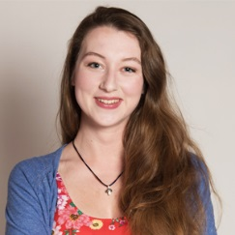
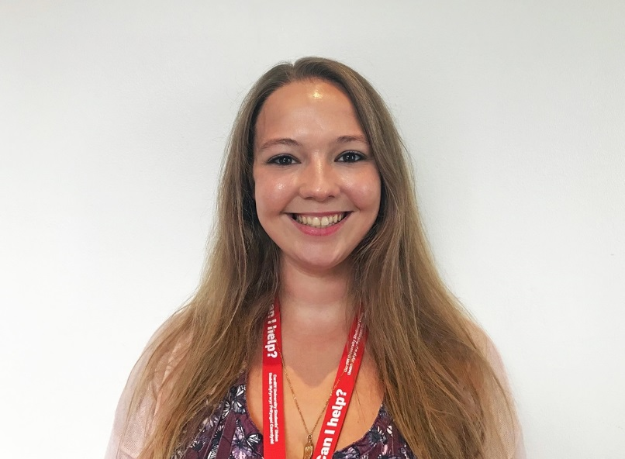
Who’s who?
Henri Page
VP Societies
IL Cymdeithasau
VPSocieties@Cardiff.ac.uk
029 2078 1427
Bryony Humphries
Societies Coordinator
Cylynydd Cymdeithasau
Societies@Cardiff.ac.uk
029 2078 1433

Slide 3
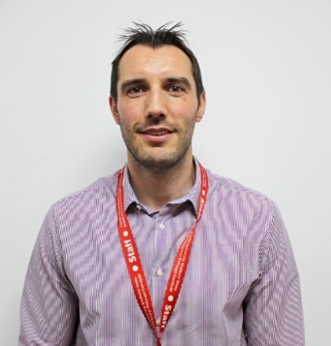
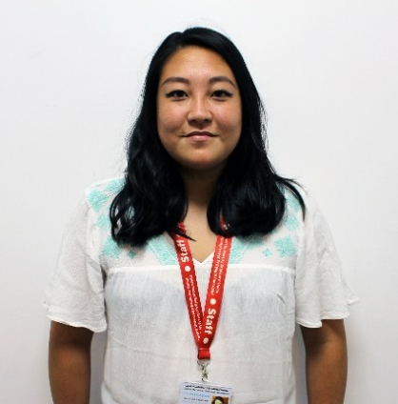
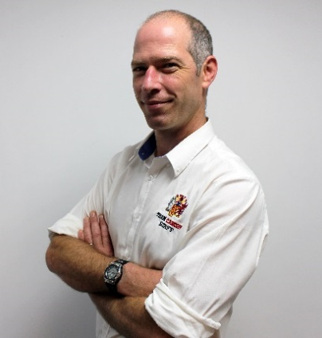
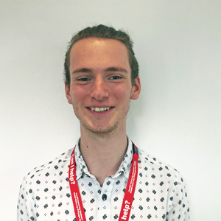
Activities Team
Tîm Gweithgareddau
Head of Student Activities
Pennaeth Gweithgareddau Myfyrwyr
Paul Jones
JonesPD4@cardiff.ac.uk
029 2078 1432
Athletic Union
Coordinator
Undeb Athletau Cydlynydd Clwb Chwaraeon
Emma Fitzpatrick
FitzpatrickE1@Cardiff.ac.uk
02920781439
Transport
Coordinator
Cydlynydd
Trafnidiaeth
Alex Bazley
SUTransport@cardiff.ac.uk
029 2078 1406
Give it a Go
Coordinator
Cydlynydd
Rho Gynnig Arni
Jess Blackman
GiveitaGo@cardiff.ac.uk
029 2078 1411

Slide 4
Societies Exec
Pwyllgor Gwaith Cymdeithasau
Activity & Appreciation Rep: You?
Course Based Rep: Ankit Agarwal
Cultural & International Rep: Emilia Jansson
Discussion, Campaigns & Awareness Rep: Otobong Mmah
Heath Based Rep: Luke Morgan
Performance & Artistic Rep: Nicola Morgan
Political & Ideological Rep: Sadiyah Ahmed
Student Led Services Rep: Orla Tarn
Cynrychiolydd Gweithgarwch a Gwerthfawrogiad: Chi?
Cynrychiolydd Seiliedig ar Gwrs: Ankit Agarwal
Cynrychiolydd Diwylliannol a Rhyngwladol: Emilia Jansson
Cynrychiolydd Trafodaeth, Ymgyrchoedd ac Ymwybyddiaeth: Otobong Mmah
Cynrychiolydd y Mynydd Bychan: Luke Morgan
Cynrychiolydd Perfformiad ac Artistig: Nicola Morgan
Cynrychiolydd Gwleidyddol ac Ideolegol: Sadiyah Ahmed
Cynrychiolydd Gwasanaethau dan arweiniad Myfyrwyr: Orla Tarn

Slide 5

The Guild of Societies
Urdd y Cymdeithasau

Slide 6
Here are a few things you will receive from us throughout the year:
Training & staff support
Use of our fleet of minibuses
A bank account
Direct funding through grants
Indirect funding: credit card fees, website hosting, free room booking…
An official Society email address
Dyma ychydig o bethau y byddwch yn derbyn oddi wrthym drwy gydol yr wythnos:
Cymorth hyfforddiant a staff
Defnyddio ein hamrywiaeth o fysiau mini
Cyfrif banc
Cyllid uniongyrchol drwy grantiau
Cyllid anuniongyrchol: ffioedd cerdyn credit, cynnal gwefan, llogi ystafell am ddim...
Cyfeiriad e-bost swyddogol Cymdeithas

Slide 7
Membership
Aelodaeth
Every member of every Society has to be a member of the Guild of Societies.
Anyone can be a member of a Society. The process is just different if you aren’t a student at Cardiff Uni.
Mae’n rhaid i bob aelod Cymdeithas fod yn aelod o Urdd y Cymdeithasau.
Gall unrhyw un fod yn aelod o Gymdeithas. Mae’r broses yn wahanol os nad ydych yn fyfyriwr ym Mhrifysgol Caerdydd.

Slide 8
What does a Committee member do?
Beth mae aelod cymdeithas yn gwneud?
You make the decisions to make sure the Society runs smoothly throughout the year.
You help decide on and arrange activities.
Your treasurer is in charge of finances, but you should all be aware of your account balance.
You are the point of contact with the Guild of Societies.
You represent your Societies needs on campus.
Chi sy’n gwneud y penderfyniadau i wneud yn siŵr bod y Gymdeithas yn cael ei redeg yn esmwyth drwy gydol y flwyddyn.
Chi sy’n helpu penderfynu ar a threfnu gweithgareddau.
Eich trysorydd sydd yn gyfrifol am gyllid, ond dylech i gyd fod yn ymwybodol o’r swm yn eich cyfrif.
Chi yw’r pwynt cyswllt gydag Urdd y Cymdeithasau.
Rydych yn cynrychioli anghenion eich Cymdeithas ar y campws.

Slide 9
Socials and Conduct
Cymdeithasol a
Ymarweddiad

Slide 10
Socials & Conduct
Cymdeithasol a Ymarweddiad
Positives:
You can set an example and take responsibility.
Integration of new members.
Opportunity to generate income/sponsorship.
Engage non-competitive members.
Ongoing team bonding.
Student experience.
Positif:
Gallwch osod esiampl a chymryd cyfrifoldeb.
Integreiddio aelodau newydd.
Cyfle i gynhyrchu incwm / nawdd.
Ymgysylltu ag aelodau an-gystadleuol.
Bondio tîm parhaus.
Profiad myfyrwyr.
Notes:
Every Club has a constitution. It will include your aims & objectives, the committee roles and regulations about meetings, finance & complaints.
You have the ability to change your constitution through amendments made in a General Meeting (AGM or EGM).
Inventories.
If you r Club has equipment then you need to make sure you have inventory of everything you own, especially if you store it within the SU.
Your equipment is only insured if it is on the inventory we hold!

Slide 11
Socials & Conduct
Cymdeithasol a
Ymarweddiad
Risks:
You are representing the University.
Public complaints.
Negative press.
Member dissatisfaction / disengagement.
Student experience.
University and SU sanctions.
Disaffiliation.
Risgiau:
Rydych yn cynrychioli'r Brifysgol.
Cwynion cyhoeddus.
Gwasg negyddol.
Anfodlonrwydd / ymddieithrio aelodau.
Profiad myfyrwyr.
Cosbau Prifysgol a UM.
Gwaharddiad.

Slide 12
Socials & Conduct
Cymdeithasol a
Ymarweddiad
SU policies:
Social and Behaviour Policy:
- Committees
- Members
Behaviour in SU licensed premises
Tier Structure – Non-alcoholic socials
Complaints procedures
Membership T & C’s
Polisïau UM:
Polisi Cymdeithasol ac Ymddygiad:
- Pwyllgorau
- Aelodau
Ymddygiad mewn eiddo trwyddedig SU
Strwythur Haen - Cymdeithasau di-alcohol.
Gweithdrefnau cwyno
Aelodaeth T & C's

Slide 13
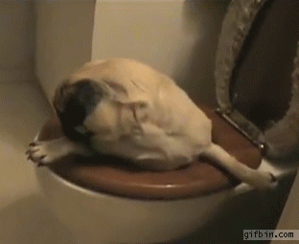
IF YOU HAVE ANY ISSUES AT ALL…
TALK TO US!!!!!

Slide 14

Finance

Slide 15
Finance Training
Hyfforddiant Cyllid

Slide 16
Learning Objectives
Amcanion Dysgu
Understand your financial responsibilities
Recognise the financial systems used and their importance
Learn how to effectively manage your group’s finances
Deall eich cyfrifoldebau ariannol
Adnabod y systemau ariannol a ddefnyddir a’u pwysigrwydd
Dysgu sut i reoli cyllid eich grwp yn effeithiol

Slide 17
Responsibilities
Cyfrifoldebau
Collecting and paying in funds
Authorising payment requests and reimbursements
Managing accounts and budgeting effectively
Applying for grants and sponsorships
Casglu a thalu arian i mewn
Awdurdodi ceisiadau am daliadau ac ad-daliadau
Rheoli cyfrifon a chyllido yn effeithiol
Gwneud cais am grantiau a nodd

Slide 18
Liability
Atebolrwydd
“Committees or individuals may be held legally responsible for loss or inappropriate use of funds during their time in office. We may require committees or individuals to repay relevant funds or refuse to reimburse expenses.”
“Gall bwyllgorau neu unigolion fod yn gyfreithiol gyfrifol am golled neu am gamddefnyddio cyllid yn ystod eu cyfnod mewn grym. Efallai byddwn yn gofyn i bwyllgorau neu unigolion ad-dalu’r symiau o arian perthnasol neu byddwn yn gwrthod ad-dalu costau.”

Slide 19
Conflicts of Interest
Buddiannau yn Gwrthdaro
Committees are volunteers
Funds are to enhance member’s experience, not just committees’
No gifts, free trips, additional discounts etc.
Cannot be paid for a service and be part of the decision-making
Pwyllgorau a gwirfoddolwyr
Mae cronfeydd yno i ehangu profiad yr aelodau, nid pwyllgorau yn unig
Dim rhoddion, teithiau am ddim, gostyngiadau ychwanegol ayyb.
Ni ddylech gael eich talu am wasanaeth a bod yn rhan o’r penderfyniadau
Notes:
This means committee members cannot be paid for coaching, teaching, photography, trip leading etc. that they provide for any club/society for which they are on the committee.

Slide 20
Understanding Your Finances
Deall eich Cyllidoedd

Slide 21
Accounts
Cyfrifon
All funds are held on trust by the Students’ Union in one, Union-wide bank account
Clubs and societies are treated as departments
Accounts are not traditional accounts
Mae pob cronfa yn cael eu dal ar ymddiriedolaeth Undeb Y Myfyrwyr mewn un cyfri banc Undeb-eang
Mae Clybiau a Chymdeithasau yn cael eu trin fel adrannau
Nid yw cyfrifon yn gyfrifon traddodiadol

Slide 22
Main Account | General account for normal income and expenditure
Reserve Account | Savings account, for contingency or long-term purchase
Activity Budget | Holds grants allocated by the Union for activities
Equipment Budget | As above, for equipment
Charity Account | Used for charitable funds raised and donations
Prif Gyfrif | Cyfrif cyffredinol ar gyfer incwm a gwariant arferol
Cyfrif wrth Gefn | Cyfrif arbedion, ar gyfer hapddigwyddiad neu daliad hir-dymor
Cyllideb Gweithgareddau | Yn dal grantiau wedi’u neilltuo gan yr Undeb ar gyfer gweithgareddau
Cyllideb Offer | Fel yr uchod, ar gyfer cyfarpar
Cyfrif Elusennol | Defnyddir ar gyfer cronfeydd elusennol a godwyd a rhoddion
Notes:
Reserve account linked to club/society tiering.
Don’t worry if an account isn’t on your statement – it doesn’t mean you don’t have it!

Slide 23
Accounts
Cyfrifon
All funds must be stored in these accounts
External/personal accounts are NOT permitted
NO personal storing of cash
Email coordinator or Finance to move money between accounts
Rhaid i bob cronfa gael eu storio yn y cyfrifon hyn
NI chaniateir cyfrifon allanol/personnol
PEIDIWCH storio arian yn bersonol
E-bostiwch y cydlynydd neu’r Swyddfa Gyllid i symud arian rhwng cyfrifon

Slide 24
Statements
Datganiadau
Available to presidents and treasurers via the committees’ portal or by request from Finance
Updated every weekday afternoon
Check regularly and in detail
Mistakes may happen but can be corrected
Ar gael i lywyddion a thrysoryddion drwy borth y pwyllgorau neu drwy gais oddi wrth y Swyddfa Gyllid
Diweddarir prynhawn bob diwrnod gwaith
Gwiriwch yn gyson ac yn fanwl
Gall gamgymeriadau ddigwydd ond mae modd eu cywiro

Slide 25
VAT
TAW
Student groups are independently constituted
Finances are recognised separately from the Union’s
Clubs and societies are not VAT registered
Mae grwpiau myfyrwyr yn gyfansoddiadol annibynnol
Mae cyllidebau yn cael eu cydnabod ar wahân i gyllideb Undeb y Myfyrwyr
Nid yw Clybiau a Chymdeithasau wedi’u cofrestru ar gyfer TAW

Slide 26
VAT
TAW
You don’t have to pay VAT on income
You must pay any VAT on expenditure
Companies cannot claim VAT on your sales or purchases
Does dim disgwyl i chi dalu TAW ar eich incwm
Mae’n rhaid talu unrhyw DAW ar wariant
Ni all cwmnïau hawlio TAW ar eich gwerthiant na phryniant

Slide 27
Managing Your Income
Rheoli Eich Incwm

Slide 28
Paying In
Talu i Mewn
Cash, card payments and cheques can be deposited at Finance
Complete a ‘Paying In Form’
Takes one working day to be allocated to your account
Finance Office has counting machines
Gall arian, taliadau cerdyn a sieciau gael eu adneuo yn y Swyddfa Gyllid
Cwblhewch ‘Ffurflen Talu i Mewn’
Mae’n cymryd un diwrnod gwaith i‘ch dyrannu i’ch cyfrif
Mae gan y Swyddfa Gyllid peiriannau cyfrif
Notes:
Can also pay in at Heath Students’ Union – but may take longer to appear on statement.

Slide 29
Paying In
Talu i Mewn
Cheques must be payable to, “Cardiff University Students’ Union”
Bank Transfer or PayPal also available – speak to Finance to arrange
All payments MUST reference your club or society
Rhaid i sieciau fod yn daladwy i, “Undeb Myfyrwyr Prifysgol Caerdydd”
Mae Trosglwyddiad Banc neu PayPal hefyd yn opsiwn - siaradwch â Cyllid er mwyn trefnu hyn
RHAID i bob taliad gyfeirnodi eich clwb neu gymdeithas

Slide 30
Websales
Gwerthiant ar y wefan
Products can be sold on the website
Quickest and safest way to collect income
Funds raised through the website are added the next working day
Produce sales reports for each product
Gall gynnyrch gael eu gwerthu ar y wefan
Y ffordd gyflymaf a mwyaf diogel i gasglu incwm
Mae cronfeydd sy’n cael eu codi drwy’r wefan yn cael eu hychwanegu y diwrnod gwaith nesaf
Cynhyrchwch adroddiadau gwerthiant i bob cynnyrch

Slide 31
Expenditure and Outgoings
Gwariant ac All-daliadau

Slide 32
Finance Requests
Ceisiadau Cyllid
Submit for EXTERNAL expenditure, such as to companies or reimburse members
Use the committees’ portal or a paper form
Requests can be paid via bank transfer, cash or cheque
Cyflwynwch ar gyfer gwariant ALLANOL megis cwmnïau neu ad-dalu aelodau
Defnyddiwch borth y pwyllgor neu ffurflen bapur
Gall ceisiadau gael eu talu drwy drosglwyddiad banc, arian parod neu siec

Slide 33
Bank Transfer | Cash | Cheque
Easiest and safest method of payment | Available to collect from Finance next working day | Can be collected or posted
Allow three to five working days for processing | Must be collected by the named payee | Available next working day
Remittance can be provided | Should only be used for small amounts | Should be avoided if possible
Trosglwyddiad Banc | Arian Parod | Siec
Y ffordd gyflymaf a mwyaf diogel i wneud taliad | Ar gael i’w gasglu o Cyllid y diwrnod gwaith nesaf | Gall gael ei gasglu neu ei bostio
Galluogwch tri i bump diwrnod gwaith i brosesu eich cais | Rhaid cael ei gasglu gan y taledig a enwir | Ar gael y diwrnod gwaith nesaf
Gellir darparu hysbysiad | Dylid ei ddefnyddio ar gyfer symiau bach yn unig | Dylid ei osgoi os yn bosib

Slide 34
Finance Requests
Ceisiadau Cyllid
Can only be submitted by treasurer/president
MUST NOT be payable to yourself
Needs to be authorised by AU/Societies staff
Always allow enough time for requests to be processed
Gall gael ei gyflwyno gan y trysorydd/llywydd yn unig
NI DDYLID fod yn daladwy i chi eich hunain
Rhaid iddo gael ei awdurdodi gan staff yr Undeb Athletaidd/ staff y Cymdeithasau
Sicrhewch eich bod yn caniatáu digon o amser i brosesu eich cais
Notes:
Requests require two signatures: club/society and staff. This is to protect committees against fraud and ensure transparency.

Slide 35
Finance Requests
Ceisiadau Cyllid
MUST have suitable evidence attached (invoices, itemised receipts etc.)
Evidence MUST show exactly where money is being spent and how much, and match the request amount
RHAID cael tystiolaeth addas wedi’i atodi (anfonebau, derbynebau eitemedig ayyb.)
RHAID i’r dystiolaeth ddangos yn union lle mae’r arian yn cael ei wario a faint, a chyd-fynd a’r swm a ofynnir amdano

Slide 36
Finance Requests
Ceisiadau Cyllid
Individuals who provide services to your group must do so on a self-employed basis
They are responsible for declaring and paying any taxes
Invoices MUST be provided – no invoice, no payment
Mae’n rhaid i unigolion sy’n darparu gwasanaethau i’ch grwp wneud hynny ar sail hunan-gyflogedig
Maen nhw’n gyfrifol am ddatgan a thalu trethi
RHAID i anfonebau gael eu darparu - dim anfoneb, dim taliad

Slide 37
Finance Requests
Ceisiadau Cyllid
Only use reputable companies and suppliers
Check all details before submitting
Make sure you have enough money available
Other options are available if necessary
Defnyddiwch gwmnïau a chyflenwyr dibynadwy yn unig
Gwiriwch y manylion i gyd cyn cyflwyno
Gwnewch yn siwr fod gennych chi ddigon o arian ar gael
Mae opsiynau eraill ar gael os oes angen
Notes:
Check details including: bank details, payment reference, correct account
Activities Team have prepaid cards, which are loaded on a purchase by purchase basis. Use of one of these can be requested by submitting a Finance Request or speaking to your relevant coordinator.

Slide 38
Floats
Fflôts
Withdraw cash from club/society account to help with sales
Must submit a finance request
List denominations of notes and coins required
Pay back in with takings
Tynnu arian parod o gyfrif clwb/cymdeithas i gynorthwyo gyda gwerthiant
Rhaid cyflwyno cais am gyllid
Rhestrwch enwadau ar gyfer unrhyw bres papur a cheiniogau sydd eu hangen
Talwch yn ôl i mewn gyda’r derbyniadau

Slide 39
Cash
Arian Parod
You should handle as little cash as possible, for as little time as possible
Cash in your possession is not insured and you are personally liable
Cash drop is available 24 hours at Finance Office (speak to Security)
Dylech ddelio gyda cyn lleied o arian parod a phosib, am gyn lleied o amser a phosib
Nid yw’r arian yn eich meddiant wedi ei yswirio ac rydych chi yn bersonol yn gyfrifol
Mae ‘cash drop’ ar gael am 24 awr yn Y Swyddfa Gyllid (siaradwch â’r adran ddiogelwch)

Slide 40
Charity Money
Arian Elusen
Students’ Union is a charity itself
Union funds cannot be donated directly or indirectly to an EXTERNAL charity
MUST only use your charity account for raising and donating
Mae Undeb y Myfyrwyr yn elusen ei hun
Ni all cyllid yr Undeb gael ei roi yn rhodd yn uniongyrchol nac yn anuniongyrchol i elusen ALLANOL
RHAID defnyddio eich cyfrif elusen yn unig i godi a rhoi arian
Notes:
You do not need to hold any funds raised for your club/society in your charity account – only for external charities

Slide 41
Charity Money
Arian Elusen
Money must be donated to the charity it was raised for
Donors must understand where their money is going
Should never be used to reimburse members
Rhaid i arian a godwyd i elusen gael ei roi i’r elusen hwnnw
Rhaid i gyfrannwyr ddeall i le mae eu harian yn mynd
Ni ddylid ei ddefnyddio i ad-dalu aelodau

Slide 42
Sponsorship
Nawdd

Slide 43
Sponsors
Noddwyr
Sell yourselves as a great investment
Be realistic about what you can offer a sponsor
Make sure you can fulfil your obligations
You cannot sell or give out members’ personal details to sponsors or external groups
Gwerthwch eu hunain fel buddsoddiad gwych
Byddwch yn realistig ynglŷn â’r hyn y gallwch chi gynnig i noddwr
Gwnewch yn siwr y gallwch gyflawni eich rhwymedigaethau
Ni allwch werthu neu roi manylion personol aelodau i noddwyr neu grwpiau allanol
Notes:
Sponsorship is external support, either financial or for goods in kind. Sponsors usually look for some form of acknowledgement or something in return.
Don’t promise something you can’t guarantee or isn’t achievable!

Slide 44
Contracts
Cytundebau
Get sponsorship agreements in writing
Any contracts must be checked by the Union first, as we may be ultimately responsible
If we don’t check, we cannot be liable
Sicrhewch fod eich cytundebau nawdd yn ysgrifenedig
Mae’n rhaid i unrhyw gytundebau gael eu gwirio gan yr Undeb yn gyntaf, fel y gallwn ni fod yn gwbl gyfrifol
Os nad ydym yn gwirio, ni allwn fod yn atebol
Notes:
The Union must check all contracts before they are signed, as they may ultimately be responsible for the terms of agreement.

Slide 45
Contracts
Cytundebau
Be as clear as possible, so both parties know what to expect
Avoid vague words and phrases like, “regular” and “significant”
Don’t be afraid to negotiate on costs, methods etc.
Byddwch mor glir a phosib, fel bod y ddau barti yn gwybod beth i’w ddisgwyl
Rhaid osgoi geiria ac ymadroddion aneglur megis, ‘cyson’ ac ‘arwyddocaol’
Peidiwch a bod ofn negodi costau, dulliau ayyb.
Notes:
The Union must check all contracts before they are signed, as they may ultimately be responsible for the terms of agreement.

Slide 46
Invoicing
Anfonebu
Once terms are agreed, most sponsors require an invoice
Request one using an ‘Invoice Request Form’
Income will be paid directly into your account
Can also invoice for other services provided
Unwaith y cytunir ar delerau, mae mwyafrif o noddwyr yn gofyn am anfoneb
Gallwch geisio am un drwy lenwi ‘Ffurflen Cyflwyno Cais am Anfoneb
Bydd incwm yn cael ei dalu yn uniongyrchol i mewn i’ch cyfrif
Gallwch anfonebu unrhyw wasanaethau eraill a ddarparwyd hefyd
Notes:
Invoice Requests can be submitted via the portal, or using the form via email or in person.
You don’t have to request an invoice, but it is helpful for all parties to track and identify payments.

Slide 47
Grants
Grantiau

Slide 48
Grant Pot
Pot Grant
Grants come from AU/Guild fee and are allocated by the Activities Team
Money is reinvested to support student group activities
Grants are a privilege, not a right
Mae’r grantiau yn dod o’r Undeb Athletaidd/Ffi’r Gild ac yn cael eu dyrannu gan y Tîm Gweithgareddau
Mae’r arian yn cael ei ail-fuddsoddi i gefnogi gweithgareddau grwpiau myfyrwyr
Mae grantiau yn fraint, nid yn hawl

Slide 49
Grant Pot
Pot Grant
We aim to fund things that:
  Help you reach your core aims
  Benefit most, or all, of your members
  Contribute to the overall student experience
Rydym yn bwriadu ariannu pethau sydd yn:
  Eich helpu i gyrraedd ei amcanion craidd
  Rhoi budd i mwyafrif, neu pob un o’ch aelodau
  Cyfrannu tuag at brofiad y myfyrwyr yn gyffredinol

Slide 50
Grant Pot
Pot Grant
Things you cannot apply for include:
  Socials
  Food and/or drink
  Accommodation
  International travel
  Clothing
  Personal equipment
Ni allwch geisio am:
  Nosweithiau Cymdeithasol
  Bwyd a/neu ddiod
  Llety
  Teithio Rhyngwladol
  Dillad
  Offer Personol
Notes:
International travel, including any UK parts of the journey
Clothing, unless it is a vital piece of safety equipment
Personal equipment (ie. used by only one person)
Publicity costs
Prizes

Slide 51
Grant Pot
Pot Grant
Things you cannot apply for include:
  Activities that have already happened (or will before the allocation is made)
  Equipment already bought (or will be purchased before the allocation is made)
Ni allwch geisio am:
  Gweithgareddau sydd eisoes wedi digwydd (neu a fydd yn digwydd cyn y dyraniad)
  Offer sydd wedi’i brynu yn barod (neu a fydd yn cael ei brynu cyn y dyraniad)

Slide 52
Decision Making
Gwneud Penderfyniadau
Will not exceed total membership income per year
Will not provide for more than two events/trips per semester
Will not exceed 50% of the total cost of trips, events or equipment
Ni fydd yn uwch na chyfanswm yr incwm aelodaeth blynyddol
Ni fydd yn darparu ar gyfer mwy nag un digwyddiad/taith bob tymor
Ni fydd arian grant yn fwy na 50% o gost cyfan taith, digwyddiad neu offer.

Slide 53
Financial Report
Adroddiad Ariannol

Slide 54
AGM
CCB
You must publish a financial report each year at AGM
Explain to your members how you used their money and why
Typically written and presented by the Treasurer
Mae’n rhaid i chi gyhoeddi eich adroddiad ariannol bob blwyddyn yn y CCB
Esbonio i’ch aelodau sut y defnyddiwyd eu harian a pham
Fel arfer yn cael ei ysgrifennu ac eu cyflwyno gan y Trysorydd
Notes:
Sponsorship is external support, either financial or for goods in kind. Sponsors usually look for some form of acknowledgement.

Slide 55
What to Include
Beth i’w Gynnwys
Balances for all accounts at the start of the year
Current account balances
Incomes from membership fees, sponsorships, etc.
Balans ar gyfer pob cyfrif ar ddechrau’r flwyddyn
Balans Cyfrif Cyfredol
Incymau o ffioedd aelodaeth, nawdd ayyb.
Notes:
Sponsorship is external support, either financial or for goods in kind. Sponsors usually look for some form of acknowledgement.

Slide 56
What to Include
Beth i’w Gynnwys
Grants awarded by the Union and how they were spent
Expenditure for key events and trips
Any other important and beneficial information
Grantiau a dderbyniwyd gan yr Undeb a sut cawsant eu gwario
Gwariant ar gyfer prif ddigwyddiadau a theithiau
Unrhyw wybodaeth pwysig a buddiol ychwanegol
Notes:
Sponsorship is external support, either financial or for goods in kind. Sponsors usually look for some form of acknowledgement.
Sample reports available online.

Slide 57
Contact Us
Cysylltwch â ni
Finance Office
3rd Floor, Students’ Union, Park Place
Open 10am – 4pm, Monday to Friday
SUFinance@cardiff.ac.uk
Y Swyddfa Gyllid
3ydd Llawr, Undeb y Myfyrwyr, Plas y Parc
Oriau Agor: 10am – 4pm, Dydd Llun i Dydd Gwener
SUFinance@caerdydd.ac.uk

Slide 58
Teithiau
Trips

Slide 59
Who, what, why and when?
Pwy, beth, pam a phryd?
Minimum of 4 weeks before your planned event.
Why are you doing this?
Who is going to pay?
What do you need to book?
When are you doing it?
O leiaf 4 wythnos cyn eich digwyddiad arfaethedig.
Pam ydych chi’n gwenud hyn?
Pwy sy’n mynd I dalu?
Beth sydd angen i chi ei harchebu?
Pryd ydych chi'n ei wneud?

Slide 60
Paperwork
Gwaith Papur
Events don’t just happen!
By completing all of the necessary paperwork, it saves you from a lot of stress (and also us!). We have created blank documents for you to use already on cardiffstudents.com
Mae angen cynllunio digwyddiadau
Trwy gwblhau'r holl waith papur angenrheidiol, mae'n eich arbed rhag llawer o straen (a hefyd ni!). Rydym wedi creu dogfennau gwag er mwyn i chi eu defnyddio eisoes ar cardiffstudents.com

Slide 61
Money, Money, Money!
Arian, Arian, Arian!
Ensure you set a budget before booking anything!
DO NOT PURCHASE/BOOK anything without speaking to us first.
If you do without speaking to us, you will be liable to cover the costs yourself.
If you have the purchase evidence/receipt you can always submit a purchase request through the online committee portal.
Sicrhewch eich bod yn gosod cyllideb cyn archebu unrhyw beth!
PEIDIWCH PRYNU / ARCHWILIO unrhyw beth heb siarad â ni yn gyntaf.
Os nad ydych chi'n siarad â ni, byddwch yn agored i dalu'r costau eich hun.
Os oes gennych y dystiolaeth / derbynneb prynu, gallwch chi bob amser gyflwyno cais am bryniant trwy'r porth pwyllgor ar-lein.

Slide 62
Promotion and Marketing
Hyrwyddo a Marchnata
Enticing people in with good marketing and promotion is a must!
The more you get can the word out there the better the trip/event will be.
Before you do put out any promotion or marketing, ensure you have everything fully booked and planned.
When that has been done you can start putting your trip/event advertising everywhere and also start taking in ticket money.
Mae’n rhaid I bobl holi pobl â marchnata a hyrwyddo
Po fwyaf y gallwch gael y gair allan yno, gwell fydd y daith / digwyddiad.
Cyn i chi roi'r gorau i unrhyw ddyrchafiad neu farchnata. Sicrhewch eich bod chi wedi archebu a chynllunio popeth yn llawn.
Pan fydd hyn wedi'i wneud, gallwch ddechrau rhoi eich taith / digwyddiad hysbysebu ym mhobman a hefyd ddechrau cymryd arian tocynnau

Slide 63
Use your committee!!!
Defnyddiwch eich pwyllgor!!!
Make sure that you make this planning process a team effort.
In doing this you will make the full committee passionate about the event/trip which will transpire into your membership wanting to also be involved by attending.
During the event TAKE PLENTY OF PHOTOS!
Sicrhewch eich bod yn gwneud ymdrech tîm i wneud y broses gynllunio hon.
Wrth wneud hyn, byddwch yn gwneud y pwyllgor llawn yn angerddol am y digwyddiad / trip a fydd yn trosglwyddo i'ch aelodaeth sydd am gymryd rhan hefyd trwy fynychu.
Yn ystod y digwyddiad GWNEUD CYNNWYS O PHOTOS!

Slide 64
Debrief
This is the part that everyone forgets about!
You want to ask your members how it went, so ask them!
Ask your committee how they felt it went.
Just make sure you ask feedback so that the club/society can record it and improve on it for next time.
Dyma'r rhan y mae pawb yn ei anghofio amdano!
Gofynnwch i'ch pwyllgor sut roedden nhw'n teimlo ei fod yn mynd.
Gwnewch yn siŵr eich bod yn gofyn am adborth fel y gall y clwb / cymdeithas ei gofnodi a'i wella ar gyfer y tro nesaf.

Slide 65
Trip Registration Cofrestru Trip
If you are travelling outside of Cardiff you must supply a trip registration to the AU before you leave.
The blank document can be found on cardiffstudents.com
We need to know where you are going, who is going and an emergency contact number in basic terms.
Os ydych chi'n teithio y tu allan i Gaerdydd mae'n rhaid i chi ddarparu taith cofrestru i'r AU cyn i chi adael.
Gellir dod o hyd i'r ddogfen wag ar cardiffstudents.com
Mae angen inni wybod ble rdych chi’n mynd, pwy sy’n mynd a rhif cyswllt argyfwng mewn termau sylfaenol.

Slide 66
Core documentation Dogfennau Craidd
It is your responsibility as the committee to ensure that all club documentation is updated and regularly checked.
Core docs are your constitution, risk assessments, code of practice and equipment inventory!
Eich cyfrifoldeb chi fel pwyllgor yw sicrhau bod holl ddogfennau'r clwb yn cael eu diweddaru a'u gwirio'n rheolaidd
Dogfennau craidd yw eich cyfansoddiad, asesiadau risg, cod ymarfer a rhestr offer offer!

Slide 67
IF YOU HAVE ANY ISSUES AT ALL…
TALK TO US!!!!!

Slide 68
Transport
Trafnidiaeth

Slide 69
The Fleet Y Cerbydau
12 Vehicles
3 x 17 Seater Minibus (including driver)
4 x 15 Seater Minibus (including driver)
1 x Van (3 Seats)
1 x Caged (9 Seats)
2 x Tourneo (9 Seats)
1 x Renault Scenic (7 Seats)
12 Cerbyd
Bws Mini 3 x 17 sedd (gan gynnwys gyrrwr)
Bws Mini 4 x 15 sedd (gan gynnwys gyrrwr)
1 x Fan (3 sedd)
1 x Cawell (9 sedd)
2 x Tourneo (9 sedd)
1 x Renault Scenic (7 sedd)

Slide 70


Hired Vehicles Cerbydau wedi’i Llogi

Slide 71
Coaches Bysiau
Mainline Coaches
NAT Coaches
Bysiau Mainline
Bysiau NAT

Slide 72
Driver
Requirements
Gofynion Gyrrwyr
Cars/9 Seaters
Requirements: 18yr + / 1 year driving experience (non-UK licence holders 2 years driving experience)
To drive SU 9 Seaters or Cars: 40 min Practical Session
Ceir/9 sedd
Gofynion: 18 blwyddyn + / 1 blwyddyn profiad gyrru (deiliaid trwydded gyrru y tu allan i’r DU 2 flwyddyn o brofiad gyrru)
I yrru Ceir neu 9 sedd yr Undeb: Sesiwn Ymarferol 40 munud

Slide 73
Continued. Parhau.
Minibuses (15 and 17 Seaters), Van
Requirements: 21yr + / 2 years driving experience / UK licence holders only
To drive SU Minibuses or the Van: 1 ½ hr Theory Session + 1 hr Practical Session
Bysiau Mini (15 a 17 Sedd), Fan
Gofynion: 21 blwyddyn + / 1 blwyddyn profiad gyrru / Deiliaid trwydded gyrru
I yrru Bysiau Mini yr Undeb neu’r Fan: Sesiwn Theori 1 ½ + Sesiwn Ymarferol 1 awr

Slide 74
Costs Costau
Cost: £35 per/person (charged to Club account) – can upgrade at no extra cost.
Upon completion of minibus theory + practical you will receive a MIDAS qualification.
Cost: £35 y person (yn dod allan o gyfrif y Clwb) – gallu uwchraddio am ddim cost ychwanegol.
Ar ôl cwblhau theori a phrawf ymarferol bws mini byddwch yn derbyn cymhwyster MIDAS.

Slide 75
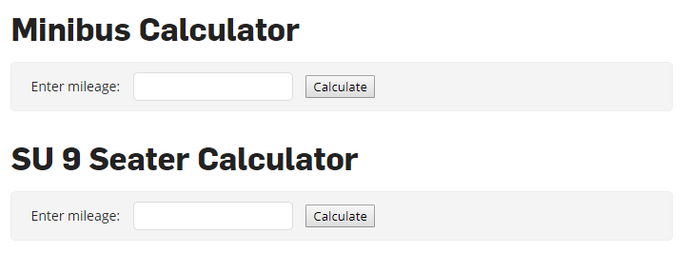
Mileage Charges Taliadau Milltiroedd
https://www.cardiffstudents.com/activities/transport/mileage/

Slide 76
Driver Registration and Sign-Ups
Cofrestru Gyrwyr
Register yourself as a driver through the Student Portal:
https://portal.cardiffstudents.com/
Sign up for minibus theory sessions online:
https://www.cardiffstudents.com/activities/transport/tests/
After the theory session you will be able to sign up for the practical session
Sign up for 9 seater practical sessions:
In the Student’s Union, or, by contacting Alex on SUTransport@Cardiff.ac.uk / 02920 781406
1. Cofrestrwch eich hun fel gyrrwr drwy Porth y Myfyrwyr: https://portal.cardiffstudents.com/
2. Cofrestrwch ar gyfer sesiynau theori bysiau mini ar-lein: https://www.cardiffstudents.com/activities/transport/tests/
Ar ôl y sesiwn theori fe fyddwch yn gallu cofrestru ar gyfer y sesiwn ymarferol
3. Cofrestrwch ar gyfer sesiwn ymarferol 9 sedd:
Yn Undeb y Myfyrwyr, neu drwy gysylltu â Alex ar SUTransport@Cardiff.ac.uk / 02920 781406

Slide 77
Vehicle Bookings Llogi Cerbydau
Online via the Student Portal (calendar view available)
Calling into the Student’s Union (3rd Floor)
Via Cardiff Students website form:
https://www.cardiffstudents.com/activities/transport/booking/
For coach bookings:
Advisable to book through the SU Transport department as we have good working relations with Mainline and other coach companies.
1. Ar-lein drwy Porth Myfyrwyr (golwg calendr ar gael)
2. Galw heibio Undeb y Myfyrwyr (3ydd llawr)
3. Drwy ffurflen gwefan Cardiff Students: https://www.cardiffstudents.com/activities/transport/booking/
Ar gyfer llogi bysiau:
Gwell archebu drwy adran Drafnidiaeth yr Undeb gan bod gennym gysylltiadau gyda Mainline a gwmnïau bysiau eraill.

Slide 78
Iechyd a diogelwch
Health and Safety

Slide 79
Eich dyletswydd gofal ac yswiriant UA
Your duty of care and AU Insurance
As an elected committee member of your society you have a moral and legal obligation to ensure the safety or well-being of society members.
On official sociaty activity this obligation is supported by the AU/Guild insurance that all members are covered under.
The insurance cover is the Elite coverage for sports clubs supplied by Endsleigh insurance.
Break down of cover can be requested.
Fel aelod pwyllgor etholedig o'ch clwb mae gennych rwymedigaeth foesol a chyfreithiol i sicrhau diogelwch a les aelodau'r clwb.
Ar weithgaredd clwb swyddogol, cefnogir yr ymrwymiad hwn gan yswiriant UA y mae'r holl aelodau yn cael ei gwmpasu.
Y clawr yswiriant yw'r sylw Elite ar gyfer clybiau chwaraeon a ddarperir gan yswiriant Endsleigh.
Gellir gofyn am ddadansoddiad.

Slide 80
Courses Cyrsiau
It’s the responsibility of the society to arrange extra courses for your membership.
SDS are able to carry out some key training such as first aid training.
Ensure you give plenty of time to register and book onto these courses.
The same goes for minibus courses, plan ahead!
Cyfrifoldeb y clwb yw trefnu cyrsiau ychwanegol ar gyfer eich aelodaeth.
Mae SDS yn medru cyflawni peth hyfforddiant allweddol fel hyfforddiant cymorth cyntaf.
Gwnewch yn siŵr eich bod yn rhoi digon o amser i chi gofrestru a threfnu'r cyrsiau hyn.
Mae'r un peth yn wir am gyrsiau minibws, cynlluniwch ymlaen!

Slide 81
GIAG

Slide 82


Slide 83
GIAG Sessions
Sesiynau Rho Gynnig Arni

Slide 84



Slide 85
‘Do our sessions have to be approved?’
‘Oes angen cymeradwyo ein sesiynau?’
Yes! GIAG sessions must be approved by myself, Societies Coordinator Bryony or AU Coordinator Emma.
If you have a guest speaker, guest speaker rules apply – speak to Bryony about any guest speaker applications. GIAG doesn’t approve these.
Oes! Mae’n rhaid i fi, Cydlynydd Cymdeithasau Bryony neu Cydlynydd UA Emma, gymeradwyo sesiynau RhGA.
Os oes gennych siaradwr gwadd, mae rheolau siaradwr gwadd yn gymwys – siaradwch â Bryony am unrhyw geisiadau siaradwr gwadd. Nid yw RhGA yn cymeradwyo rhain.

Slide 86
‘But don’t all the GIAG sessions have to happen in Freshers?’
‘Oes rhaid i holl sesiynau RhGA ddigwydd yn ystod wythnos y Glas?’
Absolutely not!
In fact, we’d like for there to be GIAG sessions from the end of September all the way up to December in this year’s GIAG booklet so that students always have an exciting GIAG event to attend!
GIAG should be a semester long opportunity.
Dim o gwbl!
Yn wir, hoffem weld sesiynau RhGA o ddiwedd Medi hyd at mis Rhagfyr yn llyfryn Rho Gynnig Arni eleni fel bod gan myfyrwyr ddigwyddiad RhGA cyffrous i fynychu bob amser!
Dylai RhGA fod ar gael drwy gydol y semester.

Slide 87
How do we submit our sessions?
'Sut rydym yn cyflwyno ein sesiynau?'
To submit a session for a GIAG Booklet please submit your sessions through the website application form.
Er mwyn cyflwyno sesiwn ar gyfer y Llyfryn, llenwch ffurflen gais ar y wefan.

Slide 88
‘Are there any other rules?’
'A oes unrhyw reolau eraill?'
You MUST have an online ticket for every GIAG session you run!
This is so we can see how many people are attending your events and so you can see too!
Even if the ticket is free you must get attendees to purchase it, if you don’t, it may mean you don’t get to run future GIAG events.
Tickets are easy to set up and we will be offering a prize for the top club and society with the most GIAG session tickets sold.
RHAID cael tocynnau ar-lein ar gyfer bob sesiwn rydych yn ei gynnal!
Mae hyn er mwyn i ni weld faint o bobl sy’n mynychu eich digwyddiadau a fel eich bod chi’n gallu gweld hefyd!
Hyd yn oes os yw’r tocyn am ddim, mae’n rhaid i chi gael mynychwyr i’w brynu, os nad ydych, gallai olygu na fyddwch yn cael cynnal digwyddiadau RhGA yn y dyfodol.
Mae tocynnau yn hawdd i’w sefydlu a byddwn yn cynnig gwobr i’r clwb a chymdeithas sy’n gwerthu’r mwyaf o sesiynau RhGA.

Slide 89
Are we allowed to use GIAG logos and branding?
‘Ydyn ni’n cael defnyddio logos a brandio RhGA?’
Yes, but you must ask before using it!
We need to know what our branding and logo is being used for, so just drop us an email and we’ll let you know if it’s appropriate for you to use.
If you use our branding without permission, you will face negative consequences depending on the case.
Ydych, ond mae’n rhaid i chi ofyn cyn ei ddefnyddio!
Mae angen i ni wybod pan fo’n brandio a logo yn cael ei ddefnyddio, felly e-bostiwch ni a rhown wybod os yw’n briodol i chi ei ddefnyddio.
Os rydych yn defnyddio ein brandio heb ganiatâd, byddwch yn derbyn cosbau negyddol yn dibynnu ar yr achos.

Slide 90
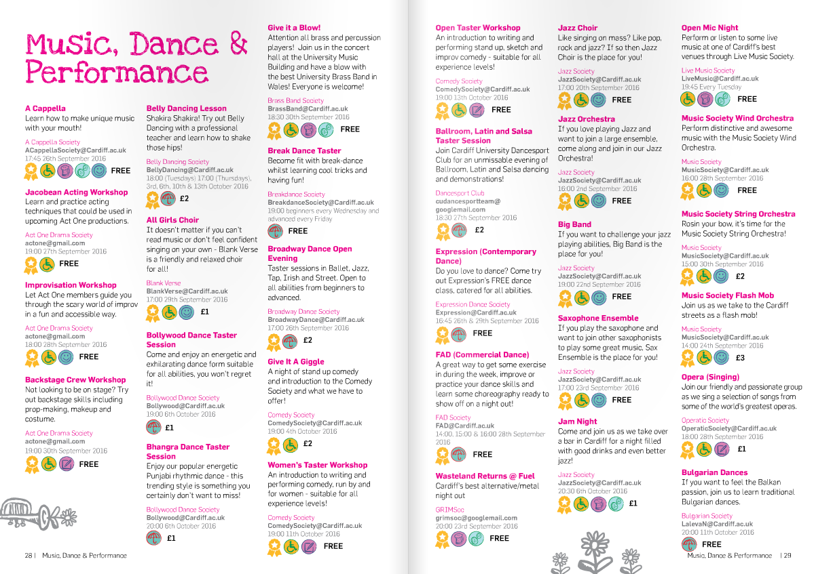
The Booklet!
Y Llyfryn!

Slide 91
Collaborating with GIAG
Cydweithio gyda Rho Gynnig Arni

Slide 92
How can we work with GIAG on bigger events and trips?
‘Sut gallwn ni weithio gyda RhGA ar ddigwyddiadau a theithiau mwy?’
We love clubs and societies and if there’s something we can help with, we will!
We can help you run abroad trips, reserve your society tickets on our day trips and give your big events a helping hand with publicity wherever possible.
If you have an idea, come and talk to us!
Rydym yn caru clybiau a chymdeithasau ac os oes rhywbeth y gallwn ni wneud i helpu, fe fyddwn yn ei wneud.
Gallwn eich helpu drefnu teithiau dramor, cadw tocynnau cymdeithas ar ein teithiau diwrnod a’ch helpu chi gyda’ch digwyddiadau mawr gyda chyhoeddusrwydd lle bo hyny’n bosibl.
Os oes gennych syniad, dewch i siarad â ni!

Slide 93
‘We want to go abroad, can GIAG help us run our trip?
‘Rydym eisiau mynd dramor, gall RhGA helpu ni drefnu ein taith?’
GIAG loves an abroad trip! In the past we’ve helped run annual trips for our History, EARTH, Law and Spanish and Italian Societies!
Email us with an idea of a destination, whether you want to fly or get a coach, reasons you want to go and your budget and we can get a plan together for your trip!
Like a travel agents but better, right!
Mae RhGA wrth ein bodd â theithiau dramor! Yn y gorffennol rydym wedi helpu trefnu teithiau blynyddol i’n Cymdeithasau Hanes, EARTH, y Gyfraith, Sbaeneg ac Eidalaidd!
Danfonwch e-bost gyda syniad o ble, os rydych eisiau hedfan neu gael bws, pam rydych chi eisiau mynd a chyllid a gallwn gynllunio eich taith gyda chi.
Fel asiant teithio ond yn well!

Slide 94
‘We want to go abroad, can GIAG help us run our trip?
‘Rydym eisiau mynd dramor, gall RhGA helpu ni drefnu ein taith?’
If you organize a trip through us, we coordinate the all the marketing, travel, accommodation, the itinerary if you’d like us to, and we even have a GIAG negotiated insurance policy that we highly recommend!
The only thing we ask if that you have a reasonable expectation of 40 people on the trip, otherwise they become far too expensive for us to run!
Os rydych yn trefnu taith gyda ni, byddwn ni’n cydlynu y marchnata i gyd, y teithio, llety, amserlen os hoffech chi, a mae hyd yn oed gennym bolisi yswiriant RhGA y byddwn yn ei annog yn fawr!
Yr unig beth rydym yn gofyn yw i chi ddisgwyl 40 o bobl ar y daith, fel arall mae’n mynd yn llawer rhy ddrud i ni redeg!

Slide 95
‘Where could we go?’
'Lle gallem fynd?'
An excellent question!
In the past we’ve been to:
Edinburgh
Dublin
Paris
Berlin
Amsterdam
Madrid
Budapest
Rome
London
So the answer is pretty much wherever you like if we can budget it for you!
Cwestiwn ardderchog!
Yn y gorffennol, rydym wedi bod i:
Caeredin
Dulyn
Paris
Berlin
Amsterdam
Madrid
Budapest
Rhufain
Llundain
Felly yr ateb yw, ble bynnag sy’n realistig o fewn eich cyllideb!

Slide 96
‘Our club/society doesn’t have enough members to go on an abroad trip, is there anything we can do?
‘Nid oes gan ein clwb/cymdeithas ddigon o aelodau i fynd ar daith tramor, oes rhywbeth gallwn ei wneud?’
Yes! You can collaborate with other clubs and societies on a trip!
If you wanted to go on a dance tour, ask other dance societies. If you want to go on a European trip, other societies or clubs might be interested in going with you!
There’s no reason why any club or society shouldn’t be able to collaborate with another club or society to go on an amazing trip with GIAG.
Oes! Gallwch gydweithio â chlybiau a chymdeithasau ar daith!
Os hoffech fynd ar daith dawns, gofynnwch wrth gymdeithasau dawns eraill. Os rydych eisiau mynd ar daith Ewropeaidd, efallai bydd gan gymdeithasau a chlybiau eraill ddiddordeb yn mynd gyda chi!
Nid oes unrhyw reswm pam na ddylai unrhyw glwb neu gymdeithas allu cydweithio gyda chlwb neu gymdeithas arall i fynd ar daith anhygoel gyda RHGA.

Slide 97
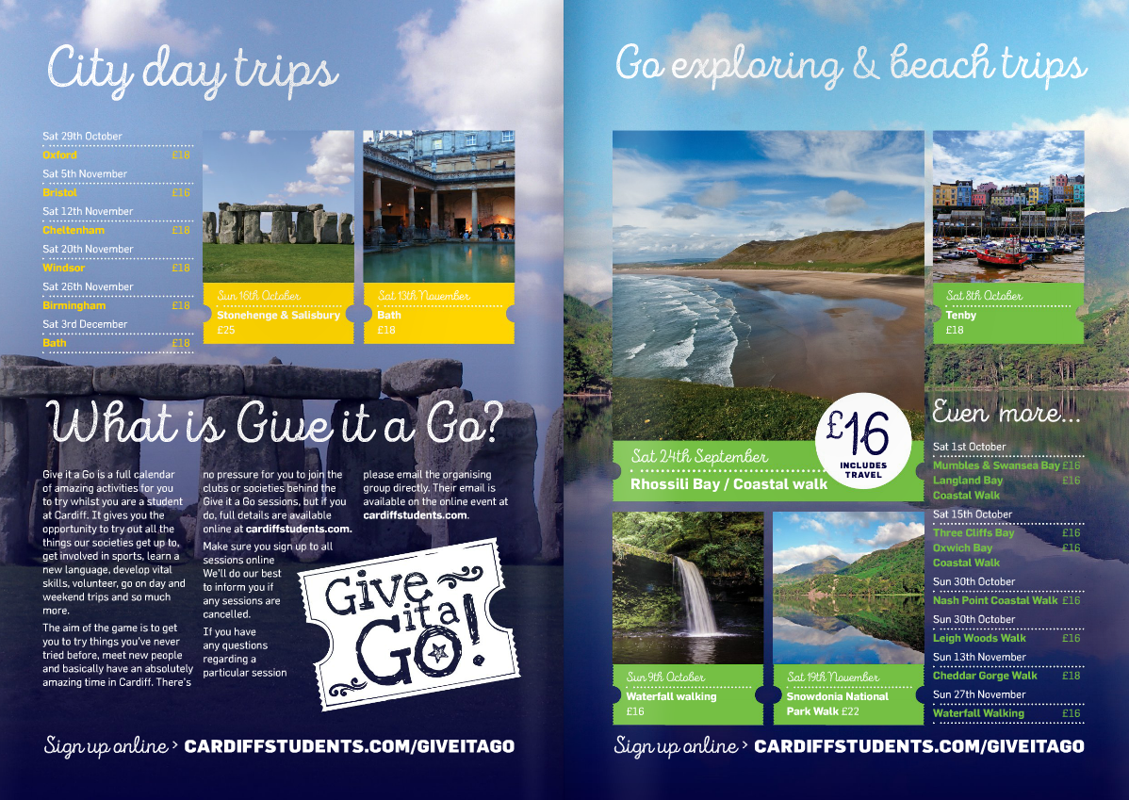

Slide 98



Social Media
Cyfryngau cymdeithasol
Give it a Go
@GiveitaGoCSU
@GiveitaGoCSU
#IGaveItAGo

Slide 99
Any Questions?
Unrhyw gwestiynau?

Slide 100

Section title to go here

Slide 101
IF YOU HAVE ANY ISSUES AT ALL…
TALK TO US!!!!!

Slide 102
Room Bookings
Archebu Ystafelloedd

Slide 103
Archebu Ystafelloedd yr Undeb
Booking SU Rooms

Slide 104
SU Room Booking System
System Archebu
Ystafelloedd yr Undeb
Book meeting rooms and stalls yourself
Request your login from Bryony
Book commercial venues and other rooms by emailing Bryony on Societies@cardiff.ac.uk
Event pack available
Archebu ystafelloedd a stondinau eich hunain
Gofynnwch am eich manylion mewngofnodi o’r Bryony
Archebwch leoliadau masnachol ac ystafelloedd eraill drwy e-bostio Bryony ar Societies@caerdydd.ac.uk
Pecyn digwyddiad ar gael

Slide 105
Terms of Use
Telerau Defnyddio
Leave all rooms as you find them
Sign out and return key at Security for all bookings
No alcohol or hot food
Delete bookings if you no longer need them
Listen to Security
Gadewch pob ystafell yn yr un cyflwr
Dychwelyd yr allwedd i Diogelwch ac arwyddo allan ar gyfer holl archebion
Dim alcohol na bwyd poeth
Dileu archebion os nad ydych eu angen bellach
Gwrando ar Ddiogelwch

Slide 106
Archebu Ystafelloedd y Brifysgol
Booking University Rooms

Slide 107
University Room Booking Form
Ffurflen Archebu y Brifysgol
You must book University Rooms through our online form
Bookings take 1-3 working days to confirm
Check Pool Rooms list to find a suitable venue
Mae’n rhaid i chi archebu Ystafelloedd y Brifysgol drwy ein ffurflen ar-lein
Gall archebion gymryd 1-3 diwrnod gwaith i’w gadarnhau
Gwiriwch rhestrau Ystafelloedd Pool i ddod o hyd i leoliad addas

Slide 108
Polisi Siaradwr Gwadd
Guest Speaker Policy

Slide 109
What is a Guest Speaker?
Beth yw Siaradwr Gwadd?
Someone given a platform to speak to students at your events or activities
Students and staff at Cardiff University are not Guest Speakers
Register coaches/ instructors using registration form
Rhywun sy’n derbyn y platfform i siarad â myfyrwyr yn eich digwyddiadau neu weithgareddau
Nid yw myfyrwyr a staff Prifysgol Caerdydd yn Siaradwyr Gwadd
Cofrestrwch hyfforddwyr gan ddefnyddio ffurflen gofrestru

Slide 110
Why does the policy exist?
Pam fod y polisi yn bodoli?
We have a responsibility to protect students and their welfare
The policy outlines a fair review of guest speakers to ensure the principles of free speech are upheld
Mae gennym gyfrifoldeb i amddiffyn myfyrwyr a’u lles
Mae’r polisi hwn yn amlinellu adolygiad teg o siaradwyr gwadd er mwyn sicrhau bod egwyddorion rhyddhad yn cael eu defnyddio

Slide 111
What events does this apply to?
Pa ddigwyddiadau sy’n berthnasol?
All events advertised under the name of the Society must comply with the policy
Guest Speakers off campus must also be declared!
Rhaid i bob digwyddiad a hysbysebir o dan enw’r Gymdeithas gydymffurfio â’r polisi
Mae’n rhaid datgan Siaradwyr Gwadd oddi ar y campws hefyd!

Slide 112
Who does this policy apply to?
Pwy sy’n gymwys i’r polisi hwn?
Our Guest Speaker policy applies to all affiliated student groups
All University Staff must seek approval for all Guest Speakers through separate channels
Mae ein polisi Siaradwr Gwadd yn berthnasol i holl grwpiau myfyrwyr cysylltiedig
Mae’n rhaid i holl Staff y Brifysgol gael cymeradwyaeth ar gyfer pob Siaradwr Gwadd drwy sianeli ar wahân

Slide 113
Your Responsibilities
Eich Cyfrifoldebau
Declare all Guest Speakers at least 21 days before the event takes place
Include all relevent information in Guest Speaker form
Do not advertise a speaker until they have been approved
Mae’n rhaid i chi ddatgan holl Siaradwyr Gwadd o leiaf 21 diwrnod cyn y digwyddiad
Sicrhewch eich bod yn cynnwys yr holl wybodaeth perthnasol yn y ffurflen Siaradwyr Gwadd
Peidiwch ag hysbysebu siaradwr nes eu bod wedi’u cymeradwyo

Slide 114
Declaring Speakers
Datgan Siaradwyr
SU rooms – email Guest Speaker form to Societies@cardiff.ac.uk
University rooms – questions included in booking form
Off campus – email Guest Speaker form to Societies@cardiff.ac.uk
Ystafelloedd yr Undeb – e-bostio ffurflen Siaradwr Gwadd at Societies@caerdydd.ac.uk
Ystafelloedd y Brifysgol – cwestiynau yn y ffurflen archebu
Oddi ar y campws – e-bostiwch ffurflen Siaradwr Gwadd at Societies@caerdydd.ac.uk

Slide 115
Declaring Speakers
Datgan Siaradwyr
Name and contacts
Topics due to be covered
Expected attendees
Speaker affiliations
Previous controversies
Likelihood of media interest
Enw a chysylltiadau
Pynciau i’w trafod
Nifer o fynychwyr disgwyliedig
Cysylltiadau siaradwyr
Dadleuon blaenorol
Tebygolrwydd o ddiddordeb y cyfryngau

Slide 116
Declaring Speakers
Datgan Siaradwyr
Research speaker(s) before submitting forms
Search for key words –
  “Controversy”
  “Banned”
  “Students Union”
Include as much information as possible
Ymchwiliwch siaradwyr cyn cyflwyno ffurflenni
Chwiliwch am eiriau allweddol-
“Dadleuol”
“Wedi’u gwahardd”
“Undeb Myfyrwyr”
Cynhwyswch gymaint o wybodaeth â phosib

Slide 117
Actions
Camau Gweithredu
Speakers will be approved or referred
Referred speakers will be researched further
University staff may be consulted
Events may be cancelled or events amended
Caiff siaradwyr eu cymeradwyo neu eu cyfeirio
Caiff siaradwyr a gyfeirir eu hymchwilio ymhellach
Gellir ymgynghori â staff y Brifysgol
Gellir canslo digwyddiadau neu newid ddigwyddiadau

Slide 118
Cancelling Events
Canslo Digwyddiadau
Cancelling an event or prevent speakers attending is a last resort
Normally only cancelled if policy isn’t followed correctly
We would much rather amend the event to make it more suitable
Canslo digwyddiad neu atal siaradwyr rhag mynychu yw’r dewis olaf
Fel arfer ond yn cael ei ganslo os nad yw’r polisi yn cael ei ddilyn yn gywir
Byddai’n well gennym newid y digwyddiad i’w gwneud yn fwy addas

Slide 119
Possible Amendments
Newidiadau Posibl
Event filmed by independent group
Event attended by staff or third party officials
Increased security
Opportunity for challenge or debate
Speeches submitted for approval beforehand
Digwyddiad yn cael ei ffilmio gan grŵp annibynnol
Staff neu swyddogion trydydd parti yn mynychu’r digwyddiad
Mwy o ddiogelwch
Cyfle i herio neu ddadlau
Cyflwyno areithiau i’w cymeradwyo o flaen llaw

Slide 120
Non Compliance
Dim Cydymffurfio
Hosting speaker without consent
Providing false or incomplete information
Seeking venue for non-Society activities
Breach of terms and conditions of venue
Cynnal siaradwr heb ganiatâd
Darparu gwybodaeth ffug neu anghyflawn
Chwilio am leoliad ar gyfer gweithgareddau y tu allan i’r Gymdeithas
Torri amodau a thelerau’r lleoliad

Slide 121
Non Compliance
Dim Cydymffurfio
Events cancelled or speakers refused entry to event
Restrictions placed on Society
Suspension or disciplinary procedures against Society or individuals in extreme cases
Canslo digwyddiadau neu gwrthod mynediad i’r siaradwyr
Cyfyngiadau ar y Gymdeithas
Gweithdrefnau atal neu ddisgyblu yn erbyn Cymdeithas neu unigolion mewn achosion eithafol

Slide 122
IF YOU HAVE ANY ISSUES AT ALL…
TALK TO US!!!!!

Slide 123
Coaching and Instructing
Hyfforddwyr

Slide 124
Coaches & Instructors
Hyfforddwyr
Committee members organise activity, not necessarily lead it.
Instructors are employed by the group and managed by committee.
Mae aelodau pwyllgor yn trefnu gweithgaredd, ddim o reidrwydd ei arwain
Mae hyfforddwyr yn cael eu talu gan y grŵp a’n cael ei reoli gan bwyllgor

Slide 125
Coaches & Instructors
Hyfforddwyr
Instructors will only be paid if they are registered with us and provide details of qualifications.
Committee members cannot get paid to lead sessions – conflict of interest.
Bydd hyfforddwyr ond yn cael eu talu os maent wedi cofrestru â ni a darparu manylion cymwysterau
Nid yw aelodau pwyllgor yn gallu cael tâl am arwain sesiynau – gwrthdaro buddiannau

Slide 126
Coaches & Instructors
Hyfforddwyr
Hysbyswch staff UM os ydych chi am i ni gysylltu â'ch hyfforddwyr ar unrhyw fater - gweinyddwr gosod ac ati
Mae arwain eich clybiau yn rhan o brofiad myfyrwyr a'ch datblygiad.
Os ydych chi'n cael anhawster i gyfathrebu â hyfforddwyr ynghylch lefelau cyfrifoldeb, rhowch wybod i ni
Notify SU staff if you want us to liaise with your coaches on any matter
Leading your Clubs is part of the student experience and your development.
If you are having difficulty communicating with coaches around levels of responsibility let us know.

Slide 127
Defnyddio cardiffstudents.com
Using cardiffstudents.com

Slide 128
Marketing Your Society
Marchnata Eich Cymdeithas

Slide 129
Stalls
Stondinau
Use Room Booking System
Contact Neil if you want a stall in the IV Lounge
Competitions, ticket sales, activities, events, campaigns, etc.
Don’t rely on passers by – drive people to your stall!
Defnyddio System Archebu Ystafell
Cysylltu â Neil os hoffech stondin yn y Lolfa IV
Cystadlaethau, gwerthu tocynnau, gweithgareddau, digwyddiadau, ymgyrchoedd ayyb.
Peidiwch â dibynnu ar bobl yn cerdded heibio – gyrrwch pobl i’ch stondin!

Slide 130
Cardiff Student Media
Cyfryngau Myfyrwyr Caerdydd
Gair Rhydd, Quench, Xpress Radio and CUTV
Invite CSM to your events!
Find contacts online:
http://cardiffstudentmedia.co.uk/
Gair Rhydd, Quench, Radio Xpress a CUTV
Gwahodd CMC i’ch digwyddiadau!
Dod o hyd i gysylltiadau ar-lein:
http://cardiffstudentmedia.co.uk/

Slide 131
Posters
Posteri
Keep posters simple – titles, locations, costs,
Use striking imagery and existing branding
Link to webpage or social media for more info
Get permission for putting up posters!
Symleiddiwch eich posteri – teitlau, lleoliadau, costau
Defnyddio delweddau a brandio presennol
Dolen i’ch tudalen gwe neu gyfryngau cymdeithasol am fwy o wybodaeth
Cael caniatâd i roi posteri i fyny!

Slide 132
Poster Screens
Posteri Sgrîn
We can add your posters to our screens
768(w) x 1280(h), JPEG file
Email to Activities Team
Include finish date for promotion
Gallwn ychwanegu eich posteri i’n sgriniau
768(lled) x 1280 (uchder), ffeil JPEG
E-bostio i’r Tîm Gweithgareddau
Cynnwys dyddiad gorffen ar gyfer yr hyrwyddo

Slide 133
Y Gymraeg
Welsh Language

Slide 134
Welsh Speakers
Siaradwyr Cymraeg
Cardiff University has a thriving Welsh speaking community
You can reach more members if you promote yourselves bilingually!
We encourage you to use the Welsh language in your communications
Mae gan Brifysgol Caerdydd gymuned ffyniannus o siaradwyr Cymraeg
Gallwch gyrraedd mwy o aelodau os fyddwch yn hyrwyddo eich hun yn ddwyieithog!
Rydym yn eich annog i ddefnyddio’r Gymraeg yn eich cyfathrebiadau

Slide 135
What can you translate?
Beth i’w gyfieithu?
Social media posts
Posters and flyers
Presentation slides
Promotional materials
Sylwadau cyfryngau cymdeithasol
Posteri a thaflenni
Sleidiau pwynt pŵer
Deunyddiau hyrwyddo

Slide 136
Other Resources
Adnoddau Eraill
Welsh Bible of key phrases – available online
Free translation service
Beibl Cymraeg yn llawn ymadroddion allweddol – ar gael ar-lein
Gwasanaeth cyfieithu am ddim

Slide 137
Translation process
Proses gyfieithu
Send your translation to WilliamsEM17@cardiff.ac.uk with the subject (Group Name – Translation Request)
For anything under 50 words, you will receive back in 2 working days, up to 100 words is 3 working days and so on.
Danfonwch eich cyfieithiadau at WilliamsEM17@Caerdydd.ac.uk gyda’r pwnc (Enw Grŵp – Cais Cyfieithu)
Ar gyfer unrhyw beth o dan 50 gair, fe fyddwch yn ei dderbyn yn ôl o fewn 2 ddiwrnod gwaith, hyd at 100 yn 3 diwrnod gwaith ayyb.

Slide 138
Translation process
Proses gyfieithu
Send translations 7 days in advance to avoid disappointment.
Danfonwch eich cyfieithiadau 7 diwrnod o flaen llaw i osgoi siom.

Slide 139
GOLDEN RULE –
DO NOT USE GOOGLE TRANSLATE
Y RHEOL AUR –
PEIDIWCH â DEFNYDDIO GOOGLE TRANSLATE

Slide 140
Diogelu Data
Data Protection

Slide 141
GDPR
“The incoming General Data Protection Regulation will impact how we collect and use personal data. There will be increased penalties for misuse, including fines for organisations and individuals.”

Slide 142
What is Personal Data?
Beth yw Data Personol?
Information relating to an “identified or identifiable person”
  Names
  Student Numbers
  Email Addresses
  Phone numbers
Gwybodaeth sy’n ymwneud â “person dynodedig neu adnabyddadwy”
Enwau
Rhifau myfyrwyr
Cyfeiriadau e-bost
Rhifau ffôn

Slide 143
How this affects you
Sut mae hyn yn effeithio arnoch chi
We highly recommend you do not collect any data except what you are given on the website
You must get explicit permission from each individual if collecting personal data
Rydym yn argymell nad ydych yn casglu unrhyw ddata oni bai beth rydych yn ei dderbyn ar y wefan
Mae’n rhaid i chi gael caniatâd penodol gan bob unigolyn os rydych yn casglu data personol

Slide 144
Examples for consent
Enghreifftiau ar gyfer caniatâd
Use a Google Form or similar to collect data
Include this questions:
“I give consent for this information to be used to contact me regarding events and trips, membership, offers and news from the xxxxx Society.”
Defnyddio Ffurflen Google neu’n debyg i gasglu data
Cynnwys y cwestiwn hwn:
“Rwyf yn rhoi caniatâd i’r wybodaeth hon gael ei ddefnyddio i gysylltu â mi ynglŷn â digwyddiadau a thripiau, aelodaeth, cynigion a newyddion gan Gymdeithas xxxxxx.”

Slide 145
Using Personal Data
Defnyddio Data Personol
Data can only be used for the purpose it was collected
You must get explicit permission for each intended purpose
You must remove data promptly if requested, including unsubscribe requests from mailing lists
Gall data ond gael ei ddefnyddio at y diben y cafwyd ei gasglu
Mae’n rhaid i chi dderbyn caniatâd penodol ar gyfer pob diben a fwriedir
Mae’n rhaid i chi ddileu data yn brydlon os gofynnir amdano, gan gynnwys dad-danysgrifio o restrau e-byst

Slide 146
Third Parties
Trydydd Parti
Do not give out or sell personal data to sponsors, external companies or anyone else
This includes accidental leaks such as not BCCing mailing lists, failing to secure personal data, etc.
Peidiwch â rhoi neu werthu data personol i noddwyr, cwmnïoedd allanol nag unrhyw un arall
Mae hyn yn cynnwys gollyngiadau damweiniol megis peidio â chuddio rhestr e-byst, methiant i sicrhau data personol ayyb.

Slide 147
Data Security
Diogelwch Data
Don’t store personal data on a public computer
Password-protect all devices with personal data on
Don’t lose USB sticks or other devices with personal data on
Peidiwch â storio data personol ar gyfrifiadur cyhoeddus
Diogelwch bob dyfais sydd â data personol gyda chyfrinair
Peidiwch â cholli cofbinau neu ddyfeisiau eraill sydd â data personol arnynt

Slide 148
Consequences of Data Misuse
Canlyniadau Camddefnyddio Data
Individual committee member(s) fined by Information Commissioner
Disciplinary action from SU or the University
SU fined by Information Commissioner
Max fine: £20 million
Dirwyo aelod(au) pwyllgor unigol gan y Comisiynydd Gwybodaeth
Camau disgyblu gan yr Undeb neu’r Brifysgol
Yr Undeb yn derbyn dirwy gan y Comisiynydd Dirwyo
Uchafswm dirwy: £20 miliwn

Slide 149
SDS & Cardiff Volunteering

Slide 150
Democracy in Student Groups
Democratiaeth mewn Grwpiau Myfyrwyr

Slide 151
Student Groups and Democracy
Grwpiau Myfyrwyr a Democratiaeth
Groups are run by students, for students
Members must be able to have their say in the running of their group
Ensure this by hosting an AGM and electing a committee
Mae grwpiau yn cael eu rhedeg gan fyfyrwyr, ar gyfer myfyrwyr
Mae’n rhaid i aelodau allu dweud eu dweud wrth redeg eu grŵp
Sicrhau hyn drwy gynnal CCB ac ethol pwyllgor

Slide 152
Cyfarfodydd Cyffredinol Blynyddol
Annual General Meetings

Slide 153
What is an AGM?
Beth yw CCB?
Meeting open to all members to discuss group progress this year
Make changes to how the group is run
Make it as accessible to your members as possible!
Cyfarfod yn agored i holl aelodau i drafod cynnydd y grŵp eleni
Gwneud newidiadau i sut mae’r grŵp yn cael ei redeg
Mor hygyrch â phosib i’ch aelodau!

Slide 154
Things to include
Pethau i’w cynnwys
Annual report – what happened this year?
Financial report – income, key events, etc.
Constitutional amendments – discuss and vote
Adroddiad blynyddol – beth sydd wedi digwydd eleni?
Adroddiad ariannol – incwm, digwyddiadau allweddol ayyb.
Newidiadau cyfansoddiadol – trafod a phleidleisio

Slide 155
Timeline
Amserlen
Hold AGMs in Spring Semester
Give two weeks’ notice to all members
Host before/during/after one of your events
Plan AGM timeline early!
Cynnal CCB yn ystod Tymor y Gwanwyn
Rhowch rybudd o bythefnos i’r holl aelodau
Cynnal cyn/yn ystod/ar ôl un o’ch digwyddiadau
Cynllunio amserlen CCB yn gynnar!

Slide 156
Adroddiad Ariannol
Financial Report

Slide 157
Financial Reports
Adroddiad Ariannol
You must publish a financial report each year at AGM
Explain to your members how you used their money and why
Normally written and presented by the Treasurer
Mae’n rhaid i chi gyhoeddi adroddiad ariannol bob blwyddyn mewn Cyfarfod Cyffredinol
Esbonio sut rydych wedi defnyddio arian eich aelodau a pham
Fel arfer wedi’i ysgrifennu a’i gyflwyno gan y Trysorydd

Slide 158
What to include
Beth i’w gynnwys
Balances for all accounts at the beginning of the year
Current account balances
Income from Membership Fees, Sponsorships, etc.
Gweddill arian ar gyfer yr holl gyfrifon ar ddechrau’r flwyddyn
Gweddill arian cyfredol
Incwm o Ffioedd Aelodaeth, Nwyddau ac ati.

Slide 159
What to include
Beth i’w gynnwys
Any Grants awarded by the Students' Union and how these were spent
Expenditure for key events or trips
Any other information you think is important
Find example report online
Unrhyw Grantiau gan Undeb y Myfyrwyr a sut y gwariwyd y rhain
Gwariant ar gyfer digwyddiadau neu dripiau allweddol
Unrhyw wybodaeth arall sy’n bwysig
Dewch o hyd i esiampl o adroddiad ar-lein

Slide 160
Etholiadau Pwyllgor
Committee Elections

Slide 161
Elections
Etholiadau
Use our online system to run your elections
All standard members must be able to run and vote in your elections
Non Cardiff Uni student members cannot run or vote
Defnyddiwch ein system ar-lein i gynnal eich etholiadau
Mae’n rhaid i aelodau cyffredinol allu sefyll a phleidleisio yn eich etholiadau
Ni all fyfyrwyr y tu allan i Brifysgol Caerdydd sefyll na phleidleisio

Slide 162
Timeline
Amserlen
Host elections in Spring Semester
Two weeks’ nominations period
5-7 days’ voting period
Email us to collect election results
Plan timeline early!
Cynnal etholiadau yn ystod tymor y Gwanwyn
Cyfnod enwebu pythefnos
Cyfnod pleidleisio 5-7 diwrnod
E-bostiwch ni i gasglu eich canlyniadau etholiad
Cynllunio amserlen yn gynnar!

Slide 163
Flexibility
Hyblygrwydd
The online system can be used flexibly to suit your needs
Vote on your phone during events/AGM
“Trickle down” – run for multiple positions
Gellir defnyddio’r system ar-lein yn hyblyg i ddiwallu eich anghenion
Pleidleisio ar eich ffôn yn ystod digwyddiadau/CCB
“Diferynnu i lawr” – sefyll am sawl rôl

Slide 164
Things to remember
Pethau i’w cofio
Only Cardiff University students can be on committee
Each committee member can only hold one position
Sub committees don’t need to be elected, but won’t be formally recognised by SU
Dim ond myfyrwyr Prifysgol Caerdydd gall fod ar y pwyllgor
Gall aelod pwyllgor ddim ond cael un rôl
Nid oes angen ethol is-bwyllgorau, ond fe fyddant yn cael eu cydnabod yn ffurfiol gan yr Undeb

Slide 165
Trosglwyddo
Handover

Slide 166
Handover
Trosglwyddo
Make notes about events, activities, challenges
Keep a handover document/file to be passed to new committee
Remember passwords!
Keep a key contacts list!
Gwnewch nodiadau am ddigwyddiadau, gweithgareddau a heriau
Cadwch ddogfen/ffeil trosglwyddo i’w roi i’r pwyllgor newydd
Cofiwch gyfrineiriau!
Cadwch rhestr o gysylltiadau allweddol!

Slide 167
IF YOU HAVE ANY ISSUES AT ALL…
TALK TO US!!!!!

Slide 168
Main events for Societies this year
Prif ddigwyddiadau Cymdeithasau eleni
SLS Week
Winter Showcase
Go Global & Cardiff Fringe
Societies Ball
Wythnos Gwasanaethau dan Arweiniad Myfyrwyr
Arddangosfa’r Gaeaf
Go Global a Fringe Caerdydd
Noson Fawreddog Cymdeithasau

Slide 169
Diolch – Unrhyw gwestiynau?
Thank You – Any Questions?

